Slide 1


Referring for a community support activity
Self-Guided learning package
Allied Health Professions’ Office of Queensland
July 2021
A partnership with Neami National and Mind Australia
Notes:
Welcome to the Referring for a Community Support Activity, Self-Guided learning package.
The PowerPoint presentation supports the toolkit for the Referring for a Community Support Activity in Mental Health Services.

Slide 2
Introduction: Model of care description
RCAiMHS
model
1. Referring for a community support activity in Mental Health Services Toolkit: Guideline & implementation resources
3. Self-guided learning package (PowerPoint & workbook)
2. Referring for a community support activity in Mental Health Services Toolkit: Companion orientation manual of community treatment & support tools
Notes:
Welcome to the Referring for a Community Support Activity, Self-guided learning package PowerPoint (the learning package).
This learning package supports the Referring for a Community Support Activity in Mental Health model of care
The model of care is support by this ‘toolkit’ that has been co-designed to improve the referral of a person with a mental health problem to a community managed organisation, it consists of:
Referring for a community support activity in Mental Health Services Tool Kit: Guideline and implementation resources that includes:
The Guideline: Referring for a Community Support Activity in Mental Health, defines responsibilities and accountabilities of Hospital and Health service mental health alcohol and other drug services staff associated with the referral and review of community support activities. The process emphasises collaborative working principles to provide communication and operational processes to facilitate the referral between organisations.
The implementation resources support the operationalisation of the Guideline. While the processes in the Guideline are recommended, the implementation resources are optional and could be applied according to the nature of the service agreement, the type of service and the specifics of the referral. The implementation resources include the list of consumer support activities, the terms for the partnership agreements, the consumer skills development model and the referral forms.
Referring for a community support activity in Mental Health Services Tool Kit: Companion orientation manual of community treatment and support tools.
The intention of the collection of community support and community treatment tools is to orientate allied health and psychosocial support workers to the type of tools that they use when supporting consumer recovery. They are optional generic resources that can be adapted for use based on the consumer needs and assessment or used as a discussion point between allied health professionals and community managed organisation staff.
Self-guided learning package that orientates Hospital and Health Service mental health and alcohol and other drugs services and community managed organisation staff that plan to implement the model of care.
It is important to emphasis the purpose of the learning package s in this package is to introduce and orientate you to the content of the toolkit.
The learning package only provides a very general overview or summary of the content in toolkit. It is suggested that if you have not already, that you read through the toolkit to become more familiar with it and use the accompanying workbook to support learning of the process.
Following the review of the learning package, your team leader and members of the governance team can also assist to support you in providing and receiving referrals in your day to day work and to answer any questions that you may have about the process.

Slide 3
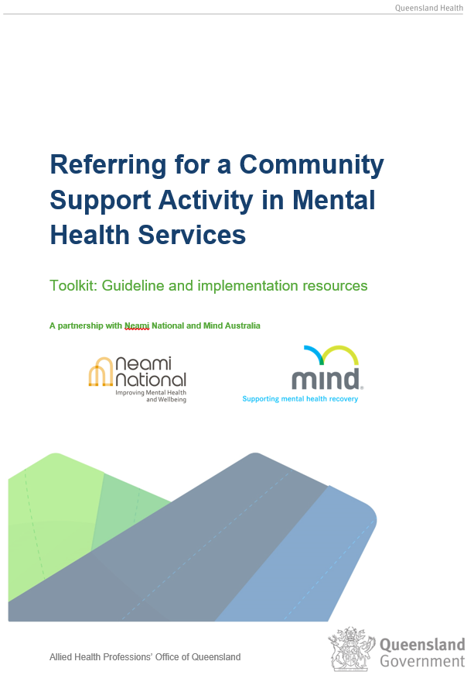
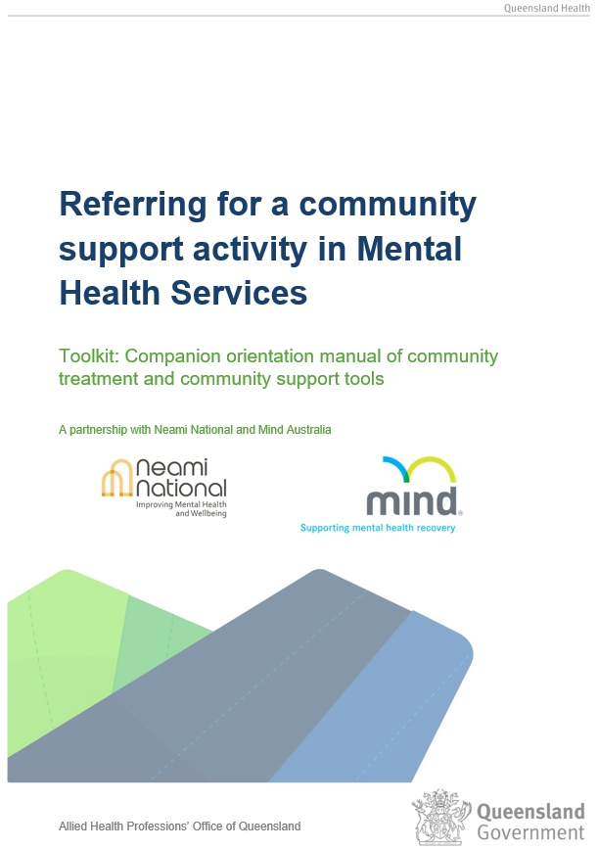
Toolkits: Referring for a Community Support Activity in Mental Health
Notes:
To support this education package you will need :
the Referring for a community support activity Toolkit: Guideline and implementation resources; and the Toolkit: companion orientation manual of community treatment and community support tools
access to the internet
The accompanying learning package workbook

Slide 4


Aims
  Understand processes, governance, roles responsibilities when referring for a community support activity
  Understand the scope of practice of community managed organisation staff
  Enhance collaboration and teamwork.
Notes:
This education package aims to consolidate:
Understanding and skills of the processes, governance, roles and responsibilities when referring for a community support activity
Enhanced understanding by the multidisciplinary team of the skills and scope of practice of psychosocial support workers, working in community managed organisations staff involved in referring for a community support activity
Enhanced collaboration and teamwork to support consumers progress towards their recovery goals.

Slide 5
Model of care: context and background
Opportunities that have not been maximised
Unique role of the psychosocial support worker to enhance recovery through community support activities
Workforce solutions to support complexity of roles
Tools to define roles
Improving the lives of people with mental illness
Notes:
Turning to the context and the background to the development of this model of care for referring for a
With government funding increasing directed to Community Managed Organisations to provide community support activities, there are opportunities for initiatives where Allied Health Professionals (AHPs) in Mental Health Alcohol and other Drug Services (MHAODS) provide community treatment activities and Community Managed Organisations provide community support activities. This model of care however, has not been maximised due to a lack of clarity around processes, governance, roles and responsibilities and mutual understanding of the scope of practice by the providers involved (Queensland Health 2017).
Significant changes have occurred to the service delivery environment for MHAOD services with the growth of CMOs providing MHAOD services with an emphasis on person-centred care, community-based treatment and support. These reforms have been positive but brought about challenges in service provision (Queensland Health, 2017). MHAOD are increasingly entering into service level agreements with CMOs to provide community treatment and support activities to optimise the support for consumers. However, providers have identified complexities around how the roles of psychosocial support workers in community managed organisations are defined and utilised. Have been opportunities to develop new workforce solutions. Tools to define, articulate and support co-design of services that were required have been developed. Redistribution of activities and processes to support appropriate referral of work to these roles can be embedded in workforce design and the models of care to improve the lives of people with a mental illness.
The Referring for a Community Support Activity in Mental Health Project (RCSAiMH) was an initiative of the Allied Health Professions’ Office of Queensland (AHPOQ), Department of Health in collaboration with Metro North HHS, West Moreton HHS, Darling Downs HHS, Cairns HHS and Mind Australia and NEAMI.

Slide 6
Introduction: Model of care description
The model enhances referrals for community support activities between allied health professionals employed in Hospital and Health services and psychosocial support workers employed through community managed organisations (and reciprocal referrals).
Other members of the multidisciplinary team may also be providing referrals.
Notes:
The Referring for a Community Support Activity in Mental Health model of care enhances referrals for community support activities between allied health professionals employed in Hospital and Health services and psychosocial support workers employed through community managed organisations. The model of care is support by this ‘toolkit’ that has been co-designed to improve the referral of a person with a mental health problem to a community managed organisation
Other members of the multidisciplinary team may also be providing

Slide 7
Guideline: Referring for a Community Support Activity in Mental Health

Slide 8
Guideline: Referring for a Community Support Activity in Mental Health
Purpose of the guideline
defines responsibilities and accountabilities of HHS MHAOD staff associated with the referral and review of community support activities
emphasises collaborative working principles to provide communication and operational processes to facilitate the referral between organisations.
Notes:
The Guideline has been prepared to facilitate referrals to community managed organisations and provides support for Hospital and Health Service (HHS) staff to refer between community managed organisations and HHS mental health and alcohol and other drugs (MHAOD) staff.
It defines responsibilities and accountabilities of HHS MHAOD staff associated with the referral and review of community support activities
The Guideline emphasises collaborative working principles to provide communication and operational processes to facilitate the referral between organisations.
This Guideline is intended to enhance allied health professional (AHP) scope of practice and support appropriate workload allocation and enhance consumer outcomes.

Slide 9

Guideline: Referring for a Community Support Activity in Mental Health
Scope
applies to allied health
has application to all MHAOD service clinicians.
Notes:
The Guideline applies to AHPs working in HHS MHAOD services. The Guideline specifically pertains to the request to community managed organisations but the principles could apply also to referral by AHP to internal HHS MHAOD services for example the peer support workforce.
Note: While these Guidelines apply to AHPs, it is understood that they could have application to all MHAOD service clinicians.

Slide 10
Model of care: Why would you refer for a community support activity?
Assist consumers to achieve recovery goals
Improve pathways to provide consumers with the right care at the right time
Support diverse services, enhance collaboration and better partnerships
Increase capacity for AHPs working in MHAOD services (and other members of the multidisciplinary team) to work to their professional scope of practice.
Notes:
Why would you refer for a community support activity?
There are several reasons including:
to assist consumers to achieve recovery goals through access to community support services that utilise a diversity of supports.
to improve health outcomes for adults with mental illness through improved pathways to provide consumers with the right care at the right time.
To support diverse services and enhance collaboration and better partnerships.
The model also has the potential to increase capacity for AHPs and the multidisciplinary team to work to their professional scope of practice

Slide 11
Model of care: services implementing the model
sub-acute services for example Adult Step Up/Step Down Units and in-reach Hospital to Home services
community services for example a case management, outreach services or transitional recovery programs
long-term services for example Community Care Units and rehabilitation services.
Notes:
Beyond this pilot, the services that implement referring for a community support activity vary and may include:
sub-acute services for example Adult Step Up/Step Down Units and in-reach Hospital to Home services.
community services for example a case management, outreach services or transitional recovery programs
long-term services for example Community Care Units and rehabilitation services.
The implementation resources within the toolkit could be applied according to the nature of the service agreement, the type of service of specifics of the referral

Slide 12
What are community support activities and community support services?
Community support activities
provided by community support services or QH
support increased opportunities for the recovery of consumers
delivered by a psychosocial support worker or a peer worker in a HHS MHAOD service
do not involve assessment, rating of performance errors or clinical decision making.
Community support activities promote skill development and include:
  consumer and carer engagement and participation
  recovery support
  information collection and recording.
Notes:
Turning now to the definitions detailed in the Guideline
Community support activities are activities that are a part of a community support service provided by a community managed organisation or HHS MHAOD service that support increased opportunities for the recovery of consumers whose lives are affected by mental illness and help realise Recovery Plans.
They are delivered by a psychosocial support worker in a community managed organisation or a peer worker in a HHS MHAOD service. These activities do not involve assessment, rating of performance errors or clinical decision making on functional performance or provision of formal therapies. They have negligible risk associated with them but are relevant to clinical care planning by the AHP.
Community support activities promote skill development and include:
consumer and carer engagement and participation
recovery support
information collection and recording
Community support services are defined as a range of services including group support, individual support, peer support and psychosocial rehabilitation for those experiencing severe and persistent mental illness as well as support for families and carers. These community support services are delivered by CMOs (Connecting Care to Recovery 2016-2021, p.11 and informed by the National Mental Health Planning Framework).

Slide 13
Examples of community support activities
Recovery support for :
  housing and accommodation
  personal activities of daily living (ADLs) e.g. establishing daily routine, personal grooming, sleep preparation
  domestic ADLs e.g. shopping, meal preparation, food safety and storage, doing laundry, doing cleaning
  instrumental ADLs e.g. using public transport, navigating appointments, going shopping, budgeting
  mental health strategies and healthy lifestyles
  social inclusion and community engagement e.g. participation in education, leisure and employment.
Notes:
What are the community support activities?
Appendix 1 of the Toolkit: Guideline and implementation resources lists frequent consumer support activities. These activities do not involve direct clinical care or clinical decision making but are relevant to clinical care planning by the multidisciplinary team. They are completed by the psychosocial support worker in the community managed organisation.
Appendix 1 details a description of what the activity involves to assist with Allied Health understanding of the scope of the psychosocial support worker
Listed on the slide are examples of community support activities that could be referred. They include, recovery support for :
housing and accommodation
personal activities of daily living (ADLs) for example support for establishing daily routine, personal grooming, sleep preparation
domestic ADLs for example support for shopping, meal preparation, food safety and storage, doing laundry, doing cleaning
instrumental ADLs for example support for using public transport, navigating appointments, going shopping, budgeting
support, mental health strategies, healthy lifestyles
social inclusion and community engagement for example support for participation in education, leisure and employment

Slide 14
Example recovery support for personal activities of daily living
Activity details
Recovery support for personal ADL’s:
  establishing a daily routine
  personal grooming
  sleep preparation.
Activity description
Support for safe and efficient ways to carry out ADLs to optimise function. This may involve routines and support that may enhance consumer independence and development of skills.
Notes:
This slide further details of an examples of two of the community support activities - recovery support for personal activities of daily living and domestic activities
Recovery support for personal activities of daily living may involve
Establishing a daily routine
Personal grooming
Sleep preparation
The activity involves support for safe and efficient ways to carry out ADLs to optimise function.
This may involve routines and support that may enhance consumer independence and development of skills.
Another example of an activity is recovery support for domestic activities of daily living including support for
Shopping
Meal preparation
Food safety and storage
The activity may include safe and efficient ways of shopping, meal preparation and food storage. This may involve routines and support that enhance consumer independence and development of skills.

Slide 15

Governance
Collaboratively developed Partnership level agreements
The terms of the agreement describe:
Clinical governance
Capacity and capability of services
Scope, type of services
Risk management
Service evaluation.
Notes:
Before the implementation of community support activities, the appropriate governance should be in place, this includes that:
Community support activities are included as part of a collaboratively developed service level agreement or local partnership agreement or equivalent, between HHS MHAOD and the community managed organisation.
The terms of the service level agreement or local partnership agreement will describe clinical governance across services including ensuring that the workforce has the capacity and capability to provide requested community support activities.
The Local partnership agreement should clearly define the extent and scope of the services provided, examples of the types of activities, and service evaluation outcomes associated with the community support activities
These agreements are in place in the pilot sites and your team leaders can guide you to this information .

Slide 16
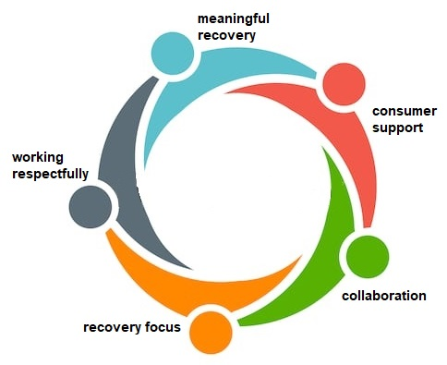
Principles of effective activity referral requests
Notes:
The Guideline outlines the overarching principles that apply when implementing community support activity practice, they include that:
The primary motivation for referring for community support activities is to serve the best interest of the consumer.
Consumers are supported to develop and maintain social, recreational, occupational and vocational activities which are meaningful to them
The AHP determines the need for the community support activities in collaboration with the consumer, carers and community managed organisation as part of joint recovery planning and the multidisciplinary team care process.
Working collaboratively and respectfully with the community managed organisation and partners is fundamental to the success of the Model of Care
Collaboration with the community managed organisation and review of the consumer’s progress toward their agreed recovery goals are integral to holistic collaborative care and should inform multidisciplinary care planning and review.

Slide 17
Prerequisites for effective service requests
  processes in place that guide information sharing
  AHP
    understand what can be referred
    orientate CMO staff to relevant QH clinical documents/forms
  collaborative practice between services
  escalation process for barriers to fulfilling community support activity
  CMO staff can provide clinical referral to the AHP if specialist input is required
  HHS staff comply with legislation
  variation in services providing the activities
  flexible use of implementation resources.
Notes:
Turning to page 2 of the Guideline, it details the prerequisites for effective service referrals
Before activities are referred:
Services involved should ensure that processes are in place to guide information sharing and communication.
AHPs should have a clear understanding of what should be referred and the related shared responsibilities and accountabilities including the scope of practice of the psychosocial support worker.
The National Framework for recovery orientated mental health services, The National practice standards for the mental health workforce and the Psychosocial Rehabilitation Support Service Standards informs the understandings of the scope of practice of the psychosocial support workers. Also referred to Appendix 1 of the activities and what they comprise
AHPs should orient Community Managed Organization staff to the relevant Queensland Health clinical documents and forms during the collaborative planning processes. Also orientate staff to the toolkit orientation manual and resources. .
Before activities are referred:
All staff are need to be aware of and uphold responsibilities and accountabilities in the provision of care for the consumer and encourage collaboration between the service sectors.
Escalation processes should be clearly defined and accessible should there be barriers to fulfilling the community support activity.
Risk management is documented in the Local Partnership agreements. Your team leaders can direct you to your local processes if you have concerns. (Leonie, Suzanne, Sam and Rebekah are going to review this at the end of the session)
There is a reciprocal arrangement/two-way referral process and the MHAOD AHP could be referred a community treatment/clinical service by psychosocial support workers in the community managed organization if input is required for consumers who meet the eligibility for assessment and treatment within the mental health service.
Finally, all HHS MHAOD employees must comply with:
legislative and policy requirements regarding confidentiality and privacy.
National Safety and Quality Health Service Standards (second edition)
National Standards for Mental Health Services (2010).
Queensland Health documentation requirements.

Slide 18
Steps in the referral process
Current documentation in place. AHP ensures
current diagnosis
clinical management and treatment plan
case review time frames
written and verbal consent by the consumer
Consumer led recover goals are developed.
collaboration between the consumer, CMO, MHAOD and stakeholders to develop consumer led recovery goals and identify support required
completed Care plan and Recovery plan
Consumer, CMO and MHAOD have a copy
Community Support Activity referral provided by AHP to CMO
Referral is agreed upon by AHP and CMO including
the type of activity to be provided
the required level of support for the consumer
the desired outcomes
process (verbally, written, telephone) for the CMO to accept referral
timeframe and process for review and feedback of the activity
process for CMO to communicate deviations from referral
process for CMO to escalate concerns about risks to consumers staff or others
Notes:
Now to the part of the Guideline that details the nuts and bots of how to refer for a community support activity. It is summarized in this flowchart on page 5 of the Guideline
Step one: the current documentation is in place. The AHP referring
ensures a current diagnosis, clinical management and treatment plan and case review timeframes are documented as a part of clinical care and the care plan.
determines whether it is appropriate to refer to the psychosocial support worker
obtains written or verbal consent from the consumer
Step two: Consumer led recovery goals are developed. Collaboration with the community managed organisation and review of the consumer led progress toward their recovery goals is part of holistic collaborative care and should inform the multidisciplinary care planning and review. This can occur
during a stakeholder or service meeting with the community managed organisation where the team leader or operational manager accepts the referral.
as a telephone referral (may not be relevant in the context of collocated services)
written referral from the AHP to the community managed organisation using an agreed procedure for referral between agencies e.g., HHS MHAOD or community support service referral procedure.
Documentation of the referral by AHP should be included in the clinical record detailing the purpose and outcome of the referral.
At the time of organizing the community support activities for the consumer the AHP needs to provide instructions about the expectations and discuss the feedback process including a description of:
the type of activity and the required level of support to be provided to the consumer e.g. activity performed with support, independently or with prompts. In Appendix 2 of the Toolkit: Companion orientation manual of community treatment and community support tools, the rating scale, is a classification tools that can be used at the referral to rate the level of support for the consumer.
The Consumer skills development model is a decision making tool that provides a common understanding between AHP, psychosocial support worker and Consumer of what the psychosocial support worker will do to support activities and how the clinical assessment may guide the process. It can be used to guide decision making to engage the consumer and can be found in Appendix 3 of the Toolkit: Guideline and implementation resources
Turning to the process for accepting referrals. Referrals should be accepted either:
verbally during a collaborative clinical or stakeholder meeting and the outcomes would be written as a part of the clinical documentation by the AHP.
through a written response using an agreed procedure for accepting referrals between agencies.
Or as a telephone referral.
The referral should include:
the time frame and process for review, completion and feedback to the HHS MHAOD staff on the community support activities.
the process for communicating deviations from the agreed support activity
the process for escalating concerns about risks to consumers, staff or others identified during the community support activity.
Appendix 4 of the Toolkit: Guideline and implementation resources provides a template to use for a referral in acute services such as step-up step-down services. The activity plan has been used as part of a handover of community support activities and used between reviews in co-located services.
Appendix 5 of the Toolkit: Guideline and implementation resources provides a template to use for a referral in long term services such as CCU’s and case management services. The form can be used by the allied health professional as a written referral as a part of the collaborative planning and appointment support.

Slide 19
Steps in the referral process continued
Case review undertaken
Case review with the consumer, CMO, MHAOD and stakeholders through one of the following processes:
MHAOD case review
review cycle of the CMO
written updates at agreed intervals
Complete the Case review form
AHP evaluates the outcomes of the referral at the
agreed time/during case review
has the activity been undertaken as agreed?
what was the level of support provided to the consumer?
where there any deviations from the planned process?
what were the timeframes for the review/completion of the community support activity?
AHP documents and communicates outcomes including
the progress of the community support activity and any changes to the agreed plan
completion of the community support activity, including if the desired outcomes were achieved, and any relevant next steps
Notes:
Step 4 of the process: Review of the community support activities detailed in the Guideline includes
A review can be conducted by one or more of the following processes:
Inviting the community managed organisation to participate in the HHS MHAOD case review meeting to provide verbal feedback on the delivery and completion of the community support activities.
AHP participation in the review cycle of the community managed organisation, which includes reviewing documentation in the clinical record.
Written updates provided by the community managed organisation at agreed intervals.
The updates will be:
timely, relevant and within the confines of what was agreed upon in the referral process.
provided prior to the agreed time period or review if staff cannot attend the collaborative meeting process.
The process should include a review of the activity being performed as one part of the AHPs evaluation of the outcomes of the care plan . The evaluation should consider the following.
whether the referred activity has been undertaken as agreed during the collaborative recovery planning process.
the level of support provided to the consumer e.g. activity performed with support, independently or with prompts.
any deviations from the planned process to provide the community support activities.
time frames for the review/completion of the community support activities.

Slide 20
Providing documentation
01
02
03
04
05
Referral
Recovery plan that supports consumer-led goals
Care plan that details support activity
Case review that reviews support activities
Record activity in CIMHA
Notes:
Where there is not a shared record, there must be a clear documentation process to support the communication between the CMO and the AHP to facilitate safe consumer access to care. Leonie and Suzanne will discuss the local implications in the next session.
AHPs are required to utilise the mental health suite of clinical documentation. Documentation should be consistent with the Mental health clinical documentation. User guide 2018 and Guideline for the Use of the Standard suite of clinical documentation 2017; which sets out minimum requirements for the use of mental health clinical documentation. Key clinical documents required for facilitating shared/collaborative care include the Care plan, Case review and Recovery plan
AHPs will document all relevant information about referrals for community support activities in the consumer’s clinical record, ensuring that information is noted as appropriate in the Care Plan, Recovery Plan and Case Review.
Information to be documented by AHPs includes:
the referral and outcome of the referral
the type/s of community support activity to be provided, the desired outcomes, and the timeframes for review and completion of the community support activity, as agreed with the consumer and the community managed organisation
updates regarding the progress of the community support activity and any changes to the agreed plan
completion of the community support activity, including whether or not the desired outcomes were achieved, and any relevant next steps.

Slide 21
Legislation
Mental Health Act 2016 (Qld)
National Standards for Mental Health Services (2010)
National Safety and Quality Health Service Standards. Second edition (2017)
Queensland Health Connecting Care to Recovery (2016-2021)
Queensland Health Guidelines for the use of the standard suite of mental health clinical documentation
Queensland Health User Guide for the Revised mental health clinical documentation
Queensland Health Clinical Supervision Guidelines for Mental Health Services
Code of Conduct for the Queensland Public Service
Notes:
The Model of care is supported by documents on the screen that detail the relevant legislation

Slide 22
Relevant documents
Human Service Quality Framework (HSQF)
A Framework for Local Implementation and Support of Skill-sharing and Delegation Practice for Allied Health Services in Queensland Public Health System
Allied Health Assistant Framework
Calderdale Framework
Delegation Training Resources
Guidelines for Skill-sharing Between Allied Health Professionals
State-wide Mental Health Allied Health Scope of Practice Project Report. Community, Adult Mental Health
The Allied Health Expanded Scope Strategy (2016-2021)
Notes:
The Model of care is also supported by the relevant documents and learning resources detailed in the PowerPoint

Slide 23
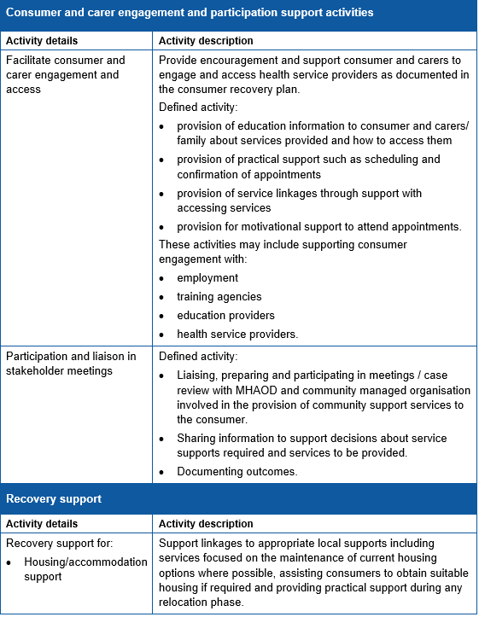
Toolkit: Guideline and implementation resources. Consumer support activities
Notes:
Now turning to the resources that support the guideline
Drawing your attention to the location of the consumer support activities that were discussed on slides 10, 11 and 12 in the presentation
Toolkit: Guideline and implementation resources. Appendix 1: List the Consumer support activities:

Slide 24
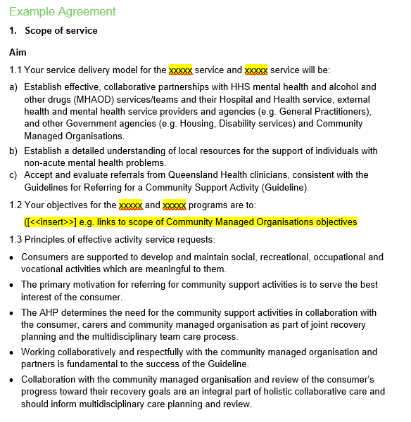
Toolkit: Guideline and implementation resource: Local Partnership agreement
Notes:
Appendix two of the Toolkit: Guideline and implementation resources provides and example of the terms for the local partnership agreement that would be used.

Slide 25
Toolkit: Guideline and implementation resource: Consumer skill development model
Skill Development Model
1. Identify individual strengths through curious conversations
2. Select an activity
3. Support Practice
4. Problem solving providing "Just the right challenge"
5. Prompting "Hierarchy of support"
6. Provide feedback and develop skill development strategies
7. Review the strategies - Screening Assessment Process
Notes:
Appendix 3: Toolkit: Guideline and implementation resources Consumer skills development model
The consumer skills development model can be used at the time of organising a referral. It guides skill development for the individual consumer. This model has been used as the basis of the support activity descriptors in Appendix C of the Toolkit: Companion orientation manual of community treatment and community support tools, but the underlying foundations could be applied to supports beyond the ones described in the toolkit. The consumer skills development model is a decision-making tool that provides a common understanding between allied health professionals, psychosocial support worker and consumer of what the psychosocial support worker will do to support activities and how the clinical assessment may guide the process. It can be used to guide decision making to engage the consumer.
Consumers may not have had the opportunity to learn and gain skills or have lost skill areas. Providing community support activities allows consumers to connect into their community and access opportunities they would not ordinarily have and fosters independence. Supporting consumers to develop or grow their skills in this area requires an understanding of their existing strengths/skill base pertaining to the community support activity to support them to grow in this area. The skill building cycle, providing just the right challenge and providing a hierarchy of support, guides skill development tailored for the individual consumer.

Slide 26
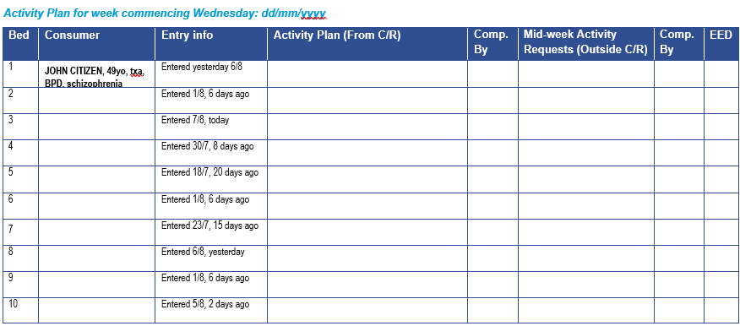
Toolkit: Guideline and implementation resource: Referral for sub-acute services: Activity plan
Notes:
Toolkit: Guideline and implementation resources. Appendix 4: Referral for sub-acute services: activity plan.
Collaboration with community managed organisations and review of consumer led progress toward their recovery goals are an integral part of holistic collaborative care and should inform multidisciplinary care planning and review. The activity plan has been found useful in sub-acute services e.g. step-up step-down units and can be used as part of a handover of community support activities and used between reviews in co-located services.

Slide 27
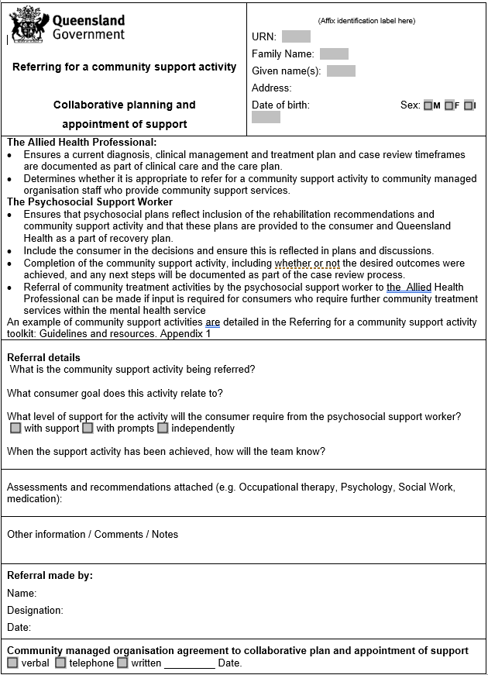
Toolkit: Guideline and implementation resource: Referral for long term services: Collaborative Planning and Appointment Support
Notes:
Toolkit: Guideline and implementation resources Appendix 5: Referral for long term services: Collaborative Planning and Appointment Support
The template has been developed services e.g. CCU or case management and can be used as part of a collaborative planning and appointment support tool when referring for a community support activity.

Slide 28
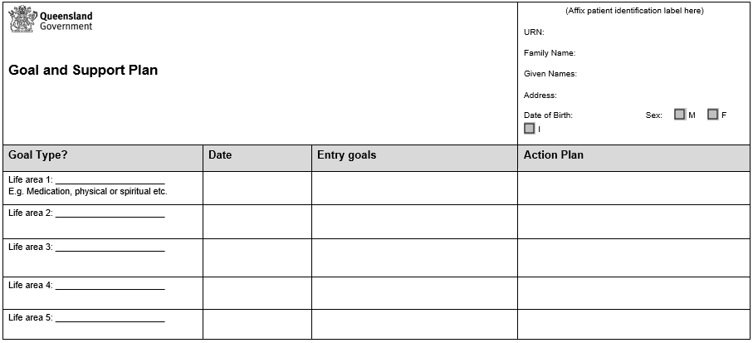
Toolkit: Companion orientation manual: Goal setting tool
Notes:
Organising community support and establishing expectation
Now we are going to look at the Toolkit: Companion orientation manual of community treatment and community support tools
I am going to move through this one, as . Appendix 1A: Goal setting tool The goal setting tool has been useful in subacute services and used to support consumer goals during their sub-acute support eg in step-up step down facilities

Slide 29
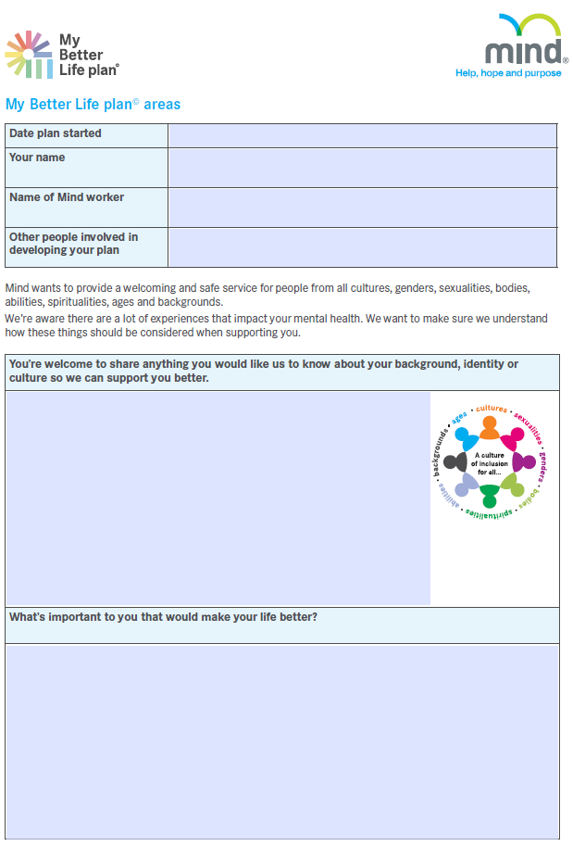
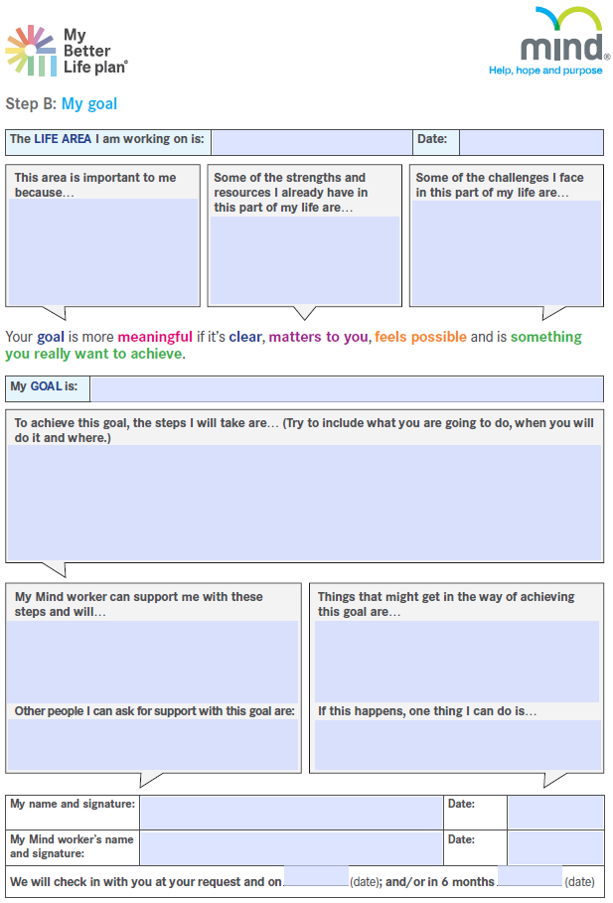
Toolkit: Companion orientation manual: My better life plan templates
Notes:
This next resource relates to organising community support and establishing expectation. The following resources require little introduction as they were developed for your services, and have been placed in the toolkit for other services who wish to utilise them.
Toolkit: Companion orientation manual of community treatment and community support tools Appendix 1B: My better life plan - A template that helps consumers identify priorities, goals and future planning. It is completed by the consumer.
Appendix 1C: My better life plan support - A support document for the My better life plan that further defines consumer goas. It is completed by the consumer.

Slide 30
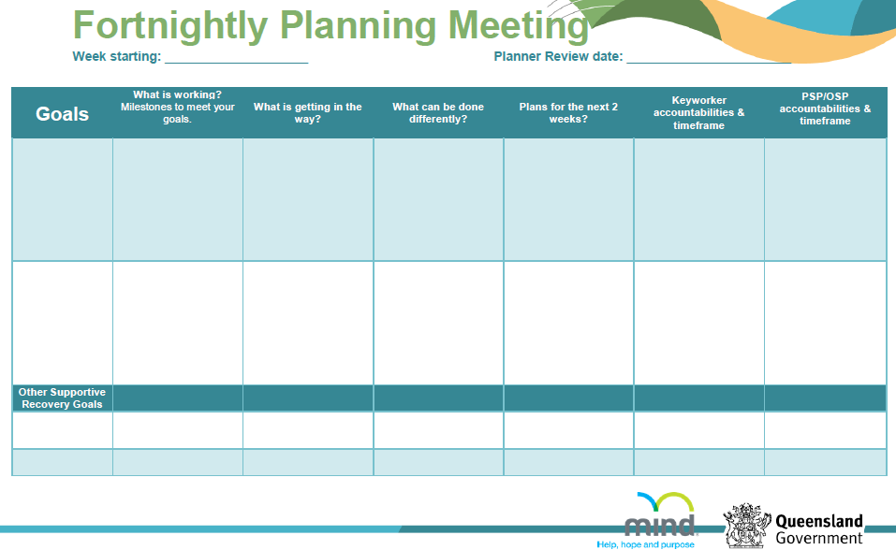
Toolkit: Companion orientation manual: Fortnightly planner
Notes:
Toolkit: Companion orientation manual of community treatment and community support tools
Appendix 1D: Fortnightly planner - The fortnightly planner was designed for a long-term support in the Continuing care unit. to address the feedback loop following the escalation of a community support activity
The template informs a brief fortnightly review with the consumer, allied health professional and psychosocial support worker.

Slide 31
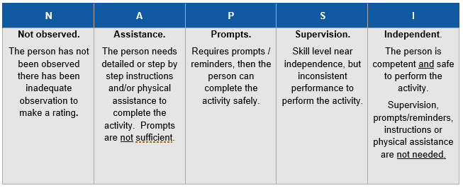
Toolkit: Companion orientation manual: Support needs rating scale
Notes:
Toolkit: Companion orientation manual of community treatment and community support tools - Appendix 2
The support needs rating scale is completed by the allied health professional based on collateral information provided or assessment undertaken by the allied health professional.
At the time of organising the community support activity for the consumer the allied health professional should provide clear instructions about the expectations and the required level of support to be provided to the consumer e.g. activity performed with support, independently or with prompts.
The support needs rating is a resource that could be used to articulate the required level of support to be provided to the consumer e.g. the activity performed with assistance, with prompts, or with supervision
It outlines the level of support on a rating scale including requiring assistance, prompts, supervision or can complete the task independently.
The rating scale has also been used as a part of the support guides to inform the evaluation

Slide 32
Toolkit: Companion orientation manual: Activity support guides
Sleep preparation
A Day meal planner
Grocery shopping
Meal preparation
Food safety and storage
Doing laundry
Doing cleaning
Catching public transport
Navigating appointments
Building independence in managing Centrelink Affairs
Budgeting support
Daily routine
Interests checklist
Notes:
Appendix 3 Toolkit: Companion orientation manual: Activity support guides
The activity support guides are optional resources that can be used to support consumers in their recovery. They use a skills development process. There are 13 support guides that have been developed and were to designed to help the Allied Health Professional understand the role of the psychosocial support worker providing community support activities. They can also be evaluated using the support needs rating scale. They activity support guides include:
Sleep preparation
A Day meal planner
Grocery shopping
Meal preparation
Food safety and storage
Doing laundry
Doing cleaning
Catching public transport
Navigating appointments
Building independence in managing Centrelink Affairs
Budgeting support
Daily routine
Interests checklist

Slide 33
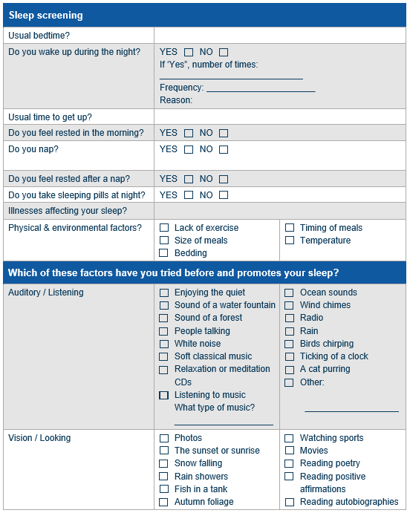
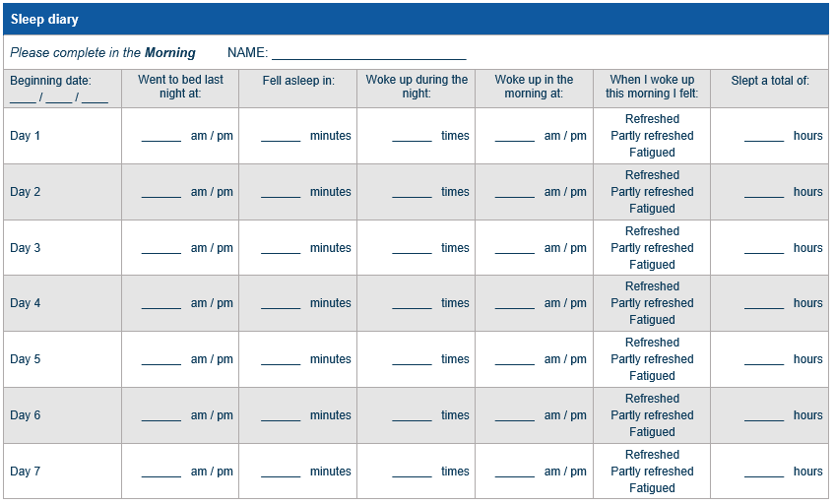
Toolkit: Companion orientation manual: Activity support guide
Notes:
Toolkit: Companion orientation manual of community treatment and community support tools - Appendix 3A
Provided are some examples of activity support guides from Appendix 3 of the Toolkit: Companion orientation manual: Activity support guide
Some have been modified from existing screening templates like this one above, the sleep screening diary and template

Slide 34
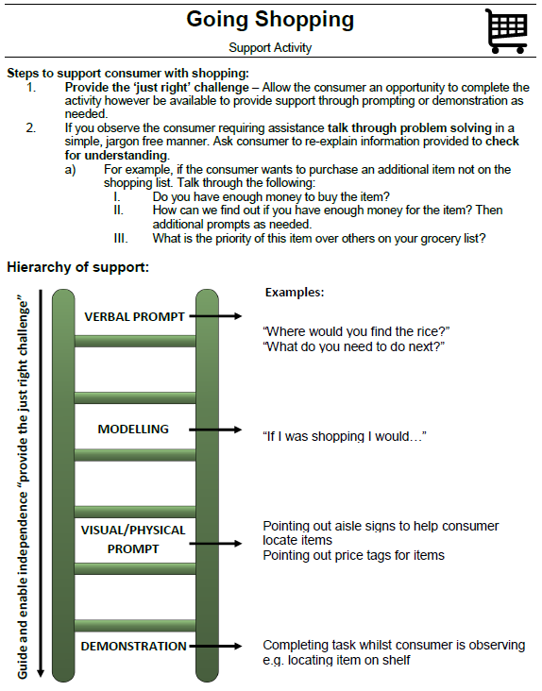
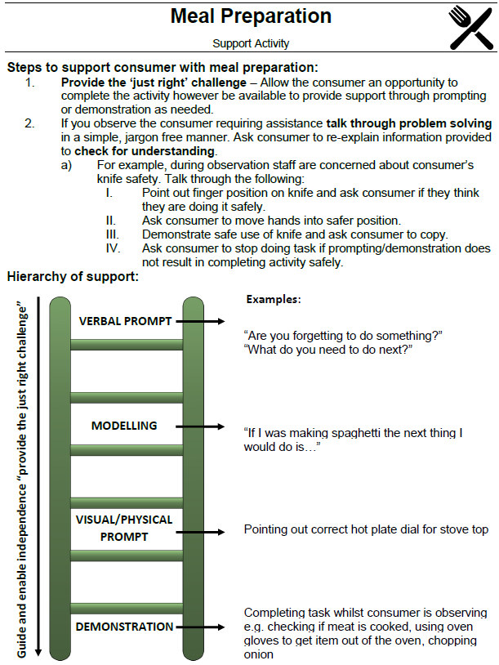
Toolkit: Companion orientation manual: Activity support guide going shopping
Notes:
Toolkit: Companion orientation manual of community treatment and community support tools
Provided are some examples of activity support guide including shopping and meal preparation

Slide 35
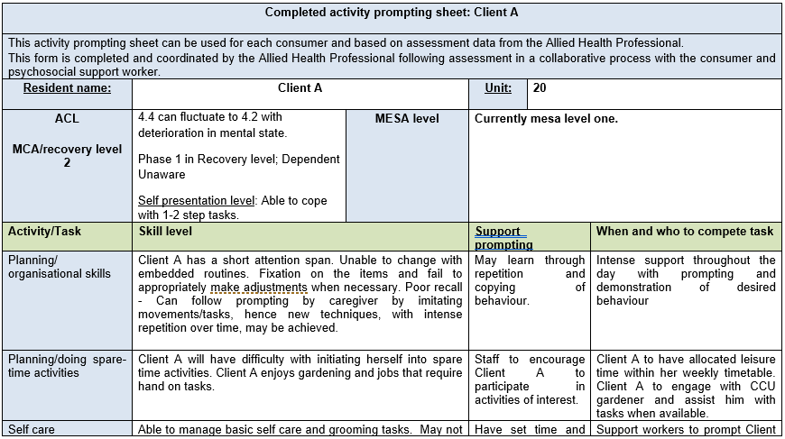
Toolkit: Companion orientation manual: Activity prompting sheet
Notes:
Appendix 4 Toolkit: Companion orientation manual: Activity prompting sheet :
These prompting sheets are completed and coordinated by AHP following assessment in a collaborative process with the consumer and psychosocial support worker. Provided for use is an empty template (prompting sheet) and two client examples of how the sheets may be completed.
The activity prompting sheet may be used to define the level of support required and explain it in more detail

Slide 36
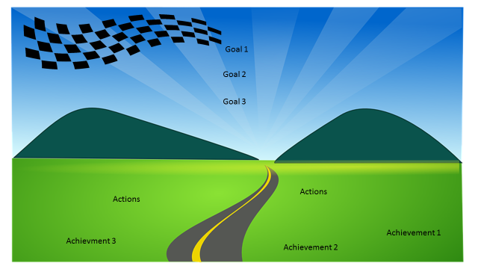
Toolkit: Companion orientation manual: Journey planner : Consumer review
Notes:
These last few resources can be used when reviewing the referred activity of the goals. This one is a consumer review tool
Review process
Appendix 5 Toolkit: Companion orientation manual: Activity prompting sheet : A journey planner is a creative visual tool reflecting and celebrating the consumers achievements as they work towards their individual recovery goals. The journey planner is completed as part of the review and the documents should go hand in hand.

Slide 37
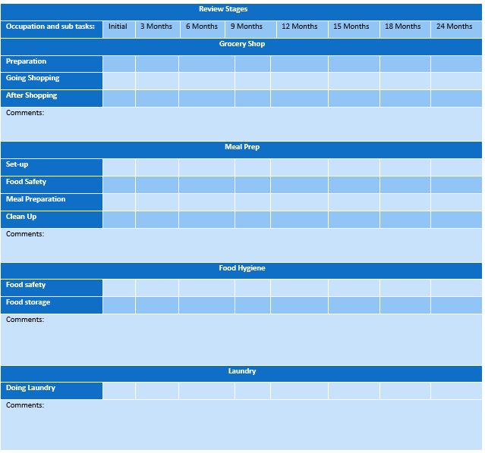
Toolkit: Companion orientation manual: Occupational therapy progress map
Notes:
Appendix 4 Toolkit: Companion orientation manual
Review process
Appendix 5E Toolkit: Companion orientation manual: The occupational therapy functional progress map . – is an occupational therapy review document
The occupational therapy functional progress map is used to track the progress of the consumers goal achievement and is a tool for discharge planning. It is completed by the occupational therapist after reviewing the support needs ratings.

Slide 38
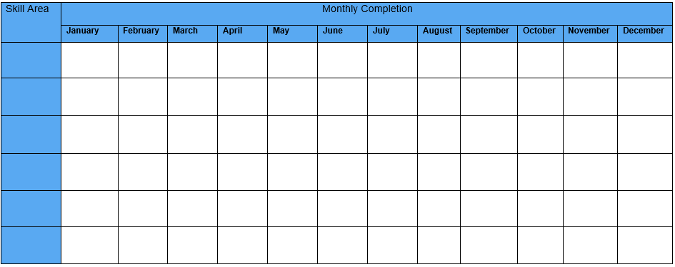
Toolkit: Companion orientation manual: Functional goals template – psychosocial support worker review
Notes:
Review process
Appendix 5F Toolkit: Companion orientation manual: Functional goals template – a psychosocial support worker review template
The functional goals template is developed between the occupational therapist, consumer and psychosocial support worker. It is used for the initial setting of collaborative goals and to document completion of supported activities. It is used by the psychosocial support worker and brought to case reviews as a part of the review process.

Slide 39
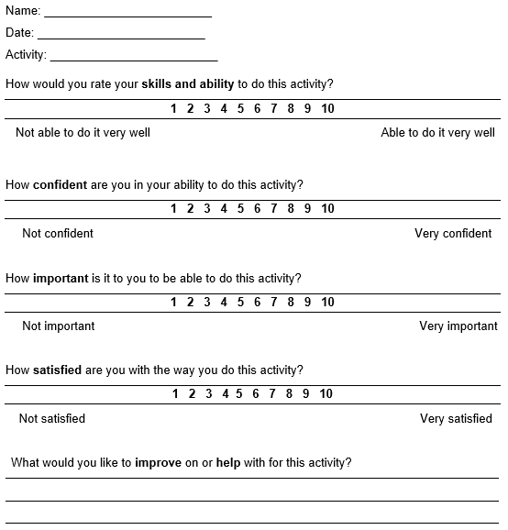
Toolkit: Companion orientation manual: Consumer activity rating scale
Notes:
Review process
Appendix 5G Toolkit: Companion orientation manual: The Consumer activity rating scale – another consumer review
The consumer activity rating scale is a self-evaluation of skill development. The consumer completes the rating scale following a specific community support activity provision by the psychosocial support worker. It can be completed at any frequency that the support worker determines to evaluate the progress of the activity and is used as a part of the occupational therapy functional progress map evaluation

Slide 40
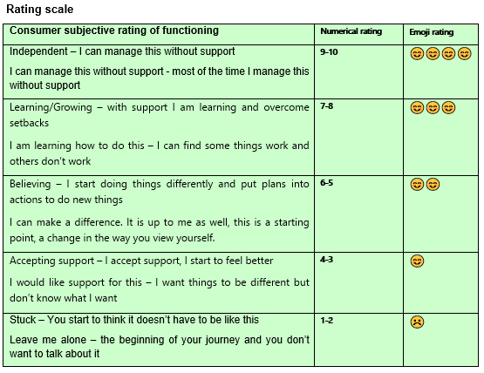
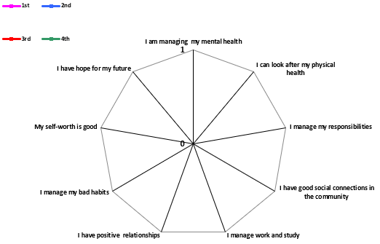
Toolkit: Companion orientation manual: Recovery web – used by the MDT.
Notes:
Review process
Appendix 5H Toolkit: Companion orientation manual: Recovery web
The recovery web is used for the subjective rating of functioning during Recovery. The numerical or emoji rating is scored by the consumer with the support of the psychosocial support worker. The psychosocial support worker plots the rating on the rating table and the recovery web. Once the rating is placed the consumer can prioritise their goals around the 10 key areas i.e. managing mental health, physical health, responsibilities, connections. The 1st completion of the Recovery web is one week before the 6-week case review. The 2nd to 4th completion is one week before the 3-monthly case review.

