Slide 1
Bare Below the Elbows

Slide 2
What is Bare Below the Elbows?
Bare Below the Elbows is an initiative that supports healthcare workers decontaminate their hands effectively
Bare Below the Elbows is the absence of clothing and jewellery from the elbow down to the fingertips to facilitate effective hand hygiene1
Aim is to improve the effectiveness of hand hygiene

Slide 3
Guide to Bare Below the Elbows
The effectiveness of hand hygiene may be improved when:
skin is intact,
nails are natural, short and unvarnished,
hands and forearms are free of jewellery, and
sleeves are above the elbow.

Slide 4


Slide 5


Slide 6
other considerations
Long ties and lanyards are not recommended
Retractable (or similar) ID card holders are recommended in place of lanyards and should be cleaned regularly
If ties are worn they should be tucked in or secure.2

Slide 7

Who should be ‘Bare Below the Elbows’?
All staff undertaking direct patient contact or contact with the patient’s environment.

Slide 8


Slide 9
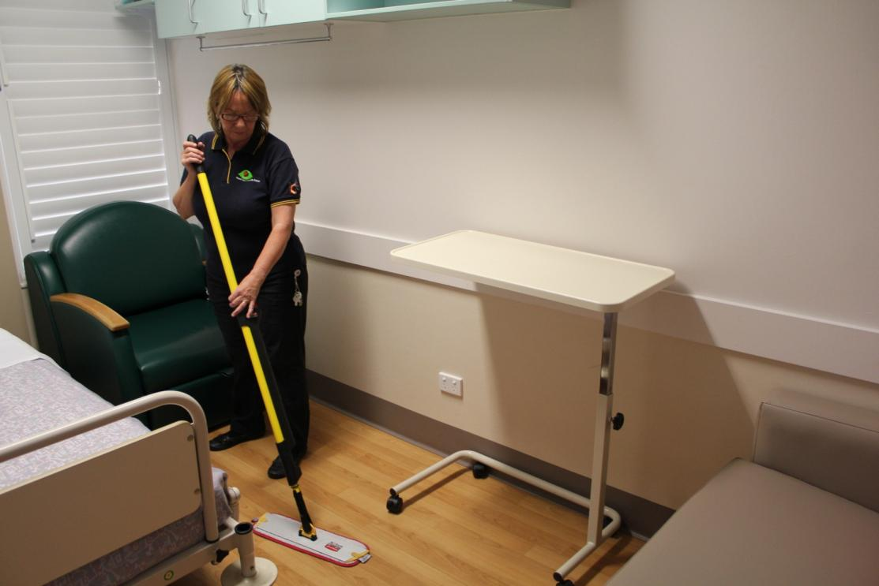

Slide 10
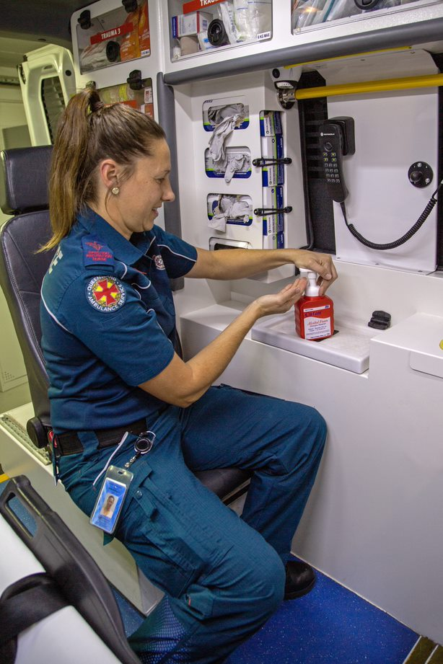

Slide 11

When should staff be ‘Bare Below the Elbows’?
Whenever having direct contact with patients or the patient’s environment.

Slide 12
Why be Bare Below the Elbows?
Hand hygiene is essential for infection prevention and control and patient and healthcare worker safety
Effective hand hygiene is one of the most important measures in the prevention of healthcare acquired infections
Bare Below the Elbows supports effective hand hygiene.

Slide 13
Why be Bare Below the Elbows?
Research suggests that wearing rings and wristwatches are associated with higher median skin organism counts.3,9
The World Health Organization recommend that long sleeves be avoided
Long sleeves and white coats have been found to be contaminated with pathogens, and impede appropriate hand hygiene.3

Slide 14
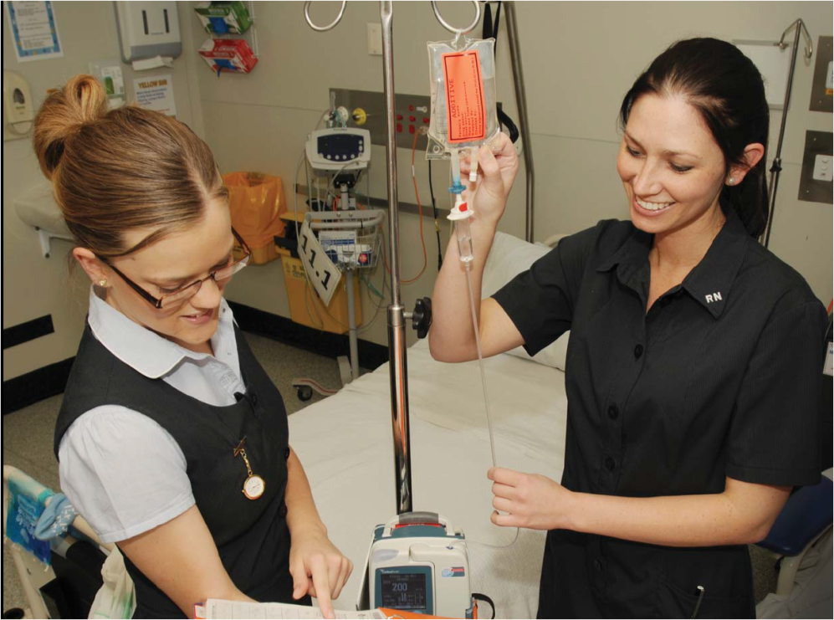

Slide 15
Why be Bare Below the Elbows?
Research conducted on healthcare worker white coats demonstrated contamination with Staphylococcus aureus, including MRSA, due to the difficulty with performing effective hand hygiene with soap and water without getting the cuffs of the sleeves wet 6,7,8
Other studies also outlined that clothing may be an important vector for patient-to-patient transmission of S. aureus 6,9

Slide 16
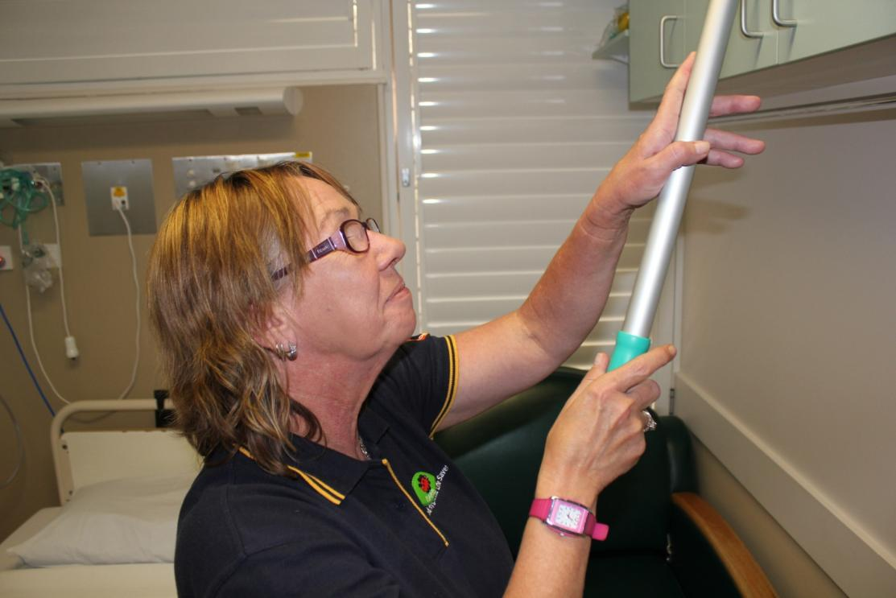
Risks of not being bare below the elbows
X Risk of higher organism counts
X Impedes effective hand hygiene

Slide 17
Bare Below the Elbows
How can I be Bare Below the Elbows?
Remove bracelets, wrist watches and rings with stones or ridges when in direct contact with patients10
A significant ring like single flat ring/band may be worn but must not interfere with effective hand hygiene practice
Ensure shirt sleeves are above the elbow and do not interfere with effective hand hygiene practice

Slide 18
continued….How can I be Bare Below the Elbows?
Keep nails short and clean and do not wear nail polish
Do not wear artificial nails (gel or acrylic) when having direct patient contact
Cover any breached skin (cuts, dermatitis or abrasion) with a waterproof film dressing
Remove protruding piercings and body modification jewellery/items positioned from the elbow to the fingertips as they impede effective hand hygiene (including but not limited to piercings or other body modifications, resulting in non-intact skin from the elbow to the fingertips)
Staff with dermatitis should report for evaluation as per local protocols.

Slide 19
continued…..How can I be Bare Below the Elbows?
Seek advice from local ICP for staff with casts or compression garments below the elbows prior to patient contact
Avoid long ties and lanyards
Use retractable (or similar) ID card holders which are recommended in place of lanyards and clean these regularly
If wearing ties ensure they are tucked in or secured.^{2,7}

Slide 20
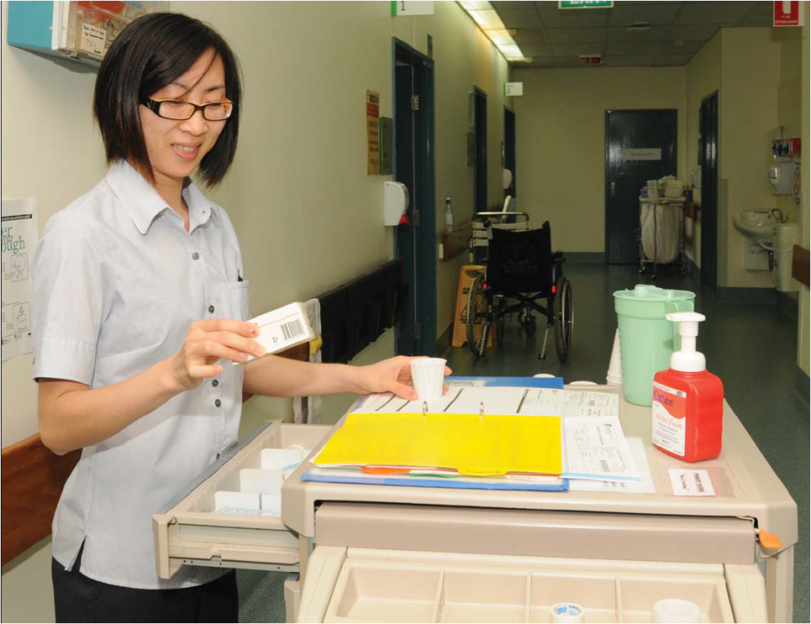

Slide 21
References
Griffin, K.J., D.J. Scott, and N. Foster, Bare below the elbows. Ann R Coll Surg Engl, 2011. 93(2): p. 181
Department of Health and Human Services (DHHS), Hand Hygiene Policy. Tasmania: DHHS, 2010. 20090713_DOC ID.DOC. Available from URL: www.dhhs.tas.gov.au/__data/assets/pdf_file/0006/72393/Hand_Hygiene_Policy_2010.pdf
Hand Hygiene Australia (HHA). Hand Hygiene Australia Manual. Australia: HHA, 2013. Available from www.hha.org.au/UserFiles/file/Manual/HHAManual_2010-11-23.pdf
Trick, W.E.; Vernon, M.O.; Hayes, R.A.; Nathan, C.; Rice, T.W.; Peterson B.J.; Segreti, J.; Welbel, S.F.; Solomon, S.L.; Weinstein, R.A. Impact of ring wearing on hand contamination and comparison of hand hygiene agents in a hospital. Clinical infectious diseases. 2003, 36(11), 1383-1390. Available from URL: www.ncbi.nlm.nih.gov/pubmed/12766832
Treakle, A.M.; Thorn, K.A.; Furuno, J.P.; Strauss, S.m.; Harris, A.D.; Perencevich, E.N.; Bacterial contamination of health care workers’ white coats. American Journal of Infection Control. 2009, 37(2), 101-105. Available from URL: www.ncbi.nlm.nih.gov/pmc/articles/PMC2892863/
Weber, R.L.; Khan, P.D.; Fader, R.C.; Weber, R.A. Prospective study on the effect of shirt sleeves and ties on the transmission of bacteria to patients. Journal of Hospital Infection. 2012. 80(3), 252-254. Available from URL: www.ncbi.nlm.nih.gov/pubmed/22305288
G.F. West,M.Resendiz and M.B.Lustik.92018) Assessing hand hygiene attitudes of inpatient nursing personnel in a US military hospital. Journal of Hospital Infection, 2018-10-01, Volume 100, Issue 2, Pages 214-217; Available from: https://doi.org/10.1016/j.jhin.2018.05.012
Emilia Szumska, Przemyslaw Czajkowski, Michal Zablocki, and Dorota Rozkiewicz, Helena Barroso. (2022). The Association between Hand Disinfection Techniques and Their Barriers, as Well as the “Bare below the Elbows” Concept, among Healthcare Professionals—A Study Based on a Polish Population, International Journal of Environmental Research and Public Health 2022, 19(18), 11781; Available from: http://doi.org./10.3390/ijerph191811781
Bearman, G., Bryant, K., Leekha, S., Mayer, J., Munoz-Price, L. S., Murthy, R., Palmore, T., Rupp, M., White, J. (2014). Expert Guidance: Healthcare Personnel Attire in Non-Operating Room Settings. Infection Control and Hospital Epidemiology, 35(2), 107-121. doi:10.1086/675066
VELVIZHI, G.d.y.c.i., et al., Wristwatches as the Potential Sources of Hospital-Acquired Infections. Journal of Clinical & Diagnostic Research, 2012. 6(5): p. 807-810.

