Slide 1
Promotional lecture template Workforce vaccination program at Insert HHS/facility name
Presenter: Insert presenter name
Notes:
This slide set is designed to be personalised for your local use. It is aimed at use for promotional in-service presentations, with limited time to present (approx 10 minutes). Please add or delete information as necessary.
Insert the name of your HHS or facility in the title. Insert the name of the presenter in the subtitle. Red text throughout requires customisation.

Slide 2
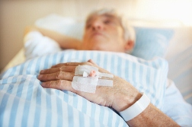
Why is vaccination important for staff?
Working in healthcare settings:
risk of exposure to vaccine preventable diseases (VPDs)
risk of transmitting a VPD to people at risk
Notes:
Clipart photo

Slide 3
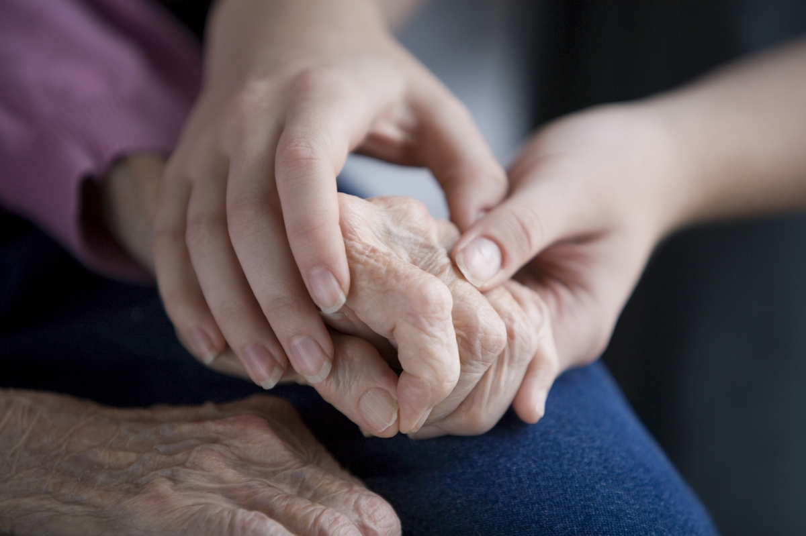
Why is vaccination important for staff?
Vaccination protects you, your family, and patients you have contact with.
Health professionals have a duty of care to protect their patients.
Notes:
Clipart photo

Slide 4
What are vaccine-preventable diseases?
A vaccine preventable disease (VPD) is an infectious disease for which an effective vaccine is available. E.g. measles, hepatitis B
Notes:
Public domain image sourced from https://pixabay.com/en/woman-blow-blowing-nose-hand-chief-698943/ no attribution required

Slide 5
What are vaccine-preventable diseases (VPDs)?
VPDs may cause:
Serious, life threatening illness and even death
Chronic (long lasting) impacts with ongoing health problems
Adverse pregnancy outcomes such as miscarriage, stillbirth and birth defects

Slide 6
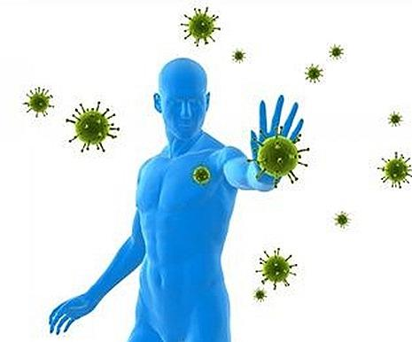
Vaccination
Vaccines are often made from parts of killed viruses or bacteria, or from live weakened strains of viruses or bacteria.
Vaccines usually induce an immune response without the harmful consequences of the infection itself.
Immunity following vaccination generally lasts for months to many years depending on the nature of the vaccine and individual factors.

Slide 7
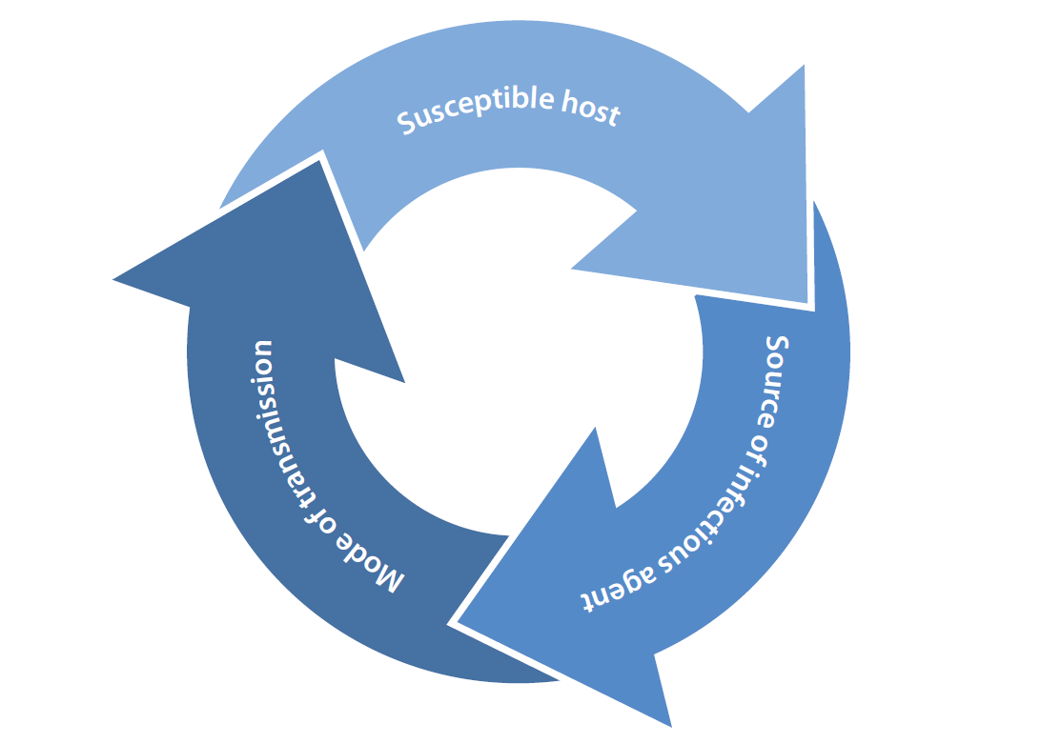
Transmission of VPDs
VPDs can be spread in a variety of ways depending on the disease, such as:
droplets (coughing, sneezing)
respiratory particles (breathing and talking - carried on air currents)
contact - blood and body fluids, fluid from vesicles (blisters), infected surfaces
faecal-oral route – ingesting something contaminated with faeces

Slide 8
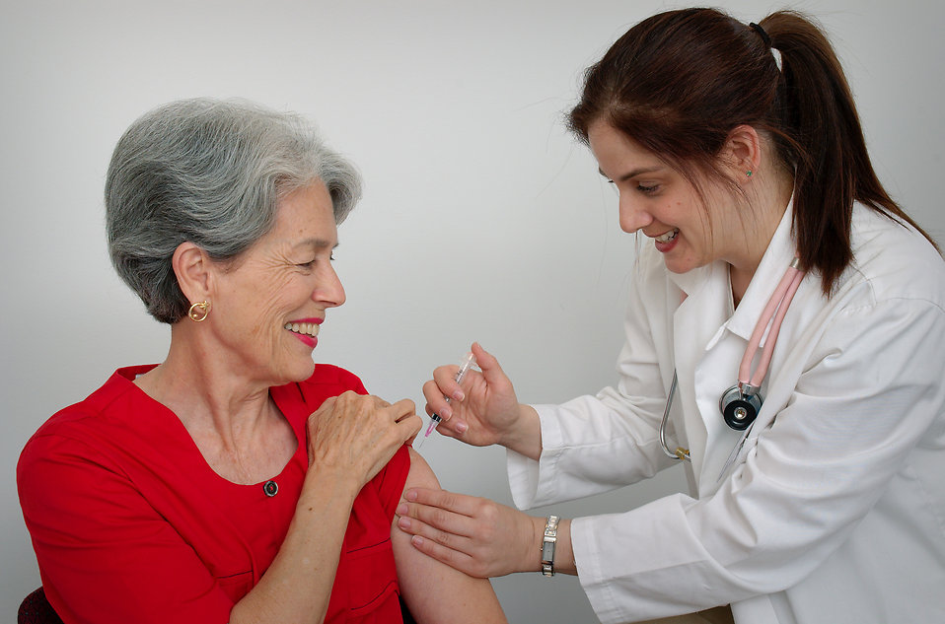
VPDs in healthcare
All healthcare workers in direct or indirect contact with patients are recommended to be vaccinated for the following:
Measles
Mumps
Rubella
Pertussis (whooping cough)
Influenza
Varicella (chickenpox)
In addition, healthcare workers who have contact with blood or body fluids are recommended to be vaccinated for:
Hepatitis B
Notes:
Clipart photo

Slide 9
VPDs in healthcare
Apart from the standard group of vaccinations, there are additional vaccination recommendations for some healthcare worker categories:
Hepatitis A
Japanese encephalitis
Screening for tuberculosis should also be undertaken for all healthcare workers working in clinical areas
Notes:
Alter according to local needs

Slide 10
What you can do
Notes:
Image CC0 public domain – no attribution required. https://pixabay.com/en/shops-partnership-cooperation-1026418/

Slide 11
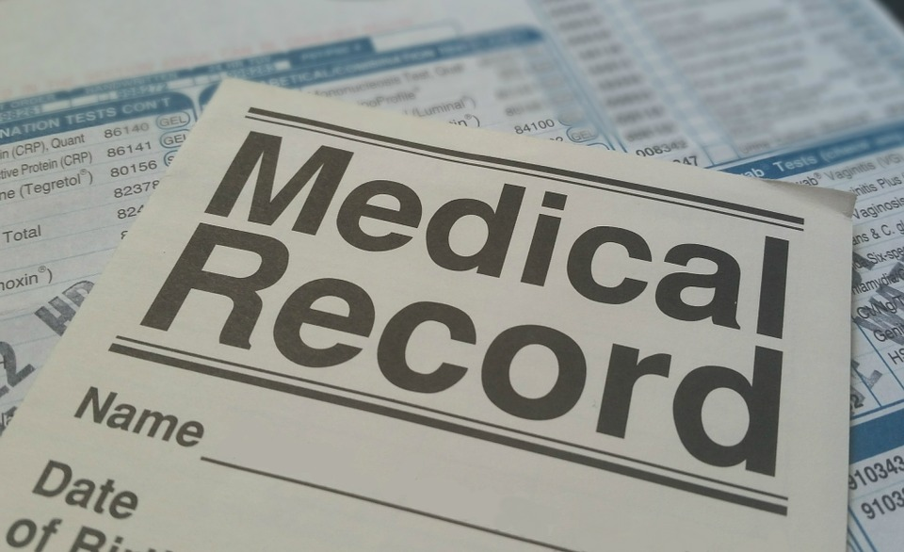
What you can do
Know your vaccination status
Provide your vaccination records to your infection control team / workforce vaccination program
You may be required to be excluded from contact with patients that have a VPD if you have no history of immunity or vaccination to that VPD.
Notes:
Image CC0 public domain from https://pixabay.com/en/medical-record-health-patient-form-781422/

Slide 12
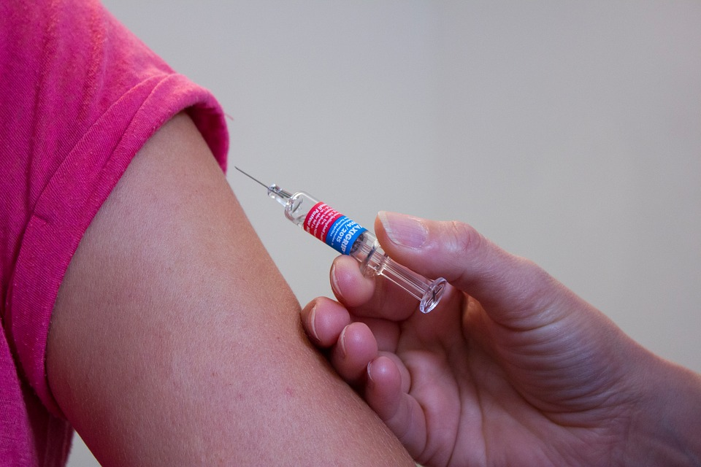
Get your vaccinations up to date
Visit insert facility / HHS staff vaccination service
Where: Place of clinic
When: Time of clinic
Appointments / Drop in clinic: Book appointment by calling xxxxxxxxxx or emailing xxxxxxx@health.qld.gov.au
Notes:
Customise for local needs
Image from https://pixabay.com/en/vaccination-doctor-syringe-medical-1215279/ No attribution required

