Slide 1
CLINICAL RESPONSE TO
Notes:
Cultural acknowledgment: “We acknowledge Aboriginal and Torres Strait Islander people as the traditional custodians of this country, and their connection to land, wind, water and community. We pay our respects to their cultures and to Elders past, present and future.”
The development of this training program was guided by consultation with expert stakeholders including partners from across the public, primary and private health systems, the community sector and a consumer with lived experience. The Department of Health is appreciative of the time and expertise provided by these expert stakeholders.
Policy context – why are we delivering this training?
The National Plan to Reduce Violence against Women and their Children 2010-2022 (the National Plan), is supported by all jurisdictions and aims to achieve a significant and sustained reduction in violence against women and their children. The National Plan focuses on stopping violence before it happens, supporting women who have experienced violence, preventing men from committing violence, and building an evidence base so we learn more about what works in reducing domestic and family violence (DFV) and sexual assault.
The National Plan aims to achieve six national outcomes:
1. Communities are safe and free from violence
2. Relationships are respectful
3. Indigenous communities are strengthened
4. Services meet the needs of women and their children experiencing violence
5. Justice responses are effective
6. Perpetrators stop their violence and are held to account
Queensland
The Special Taskforce on Domestic and Family Violence in Queensland was established to examine Queensland’s DFV support systems and make recommendations to the Premier on how the system could be improved and future incidents of domestic violence could be prevented. In February 2015, the Not Now, Not Ever: Putting an End to Domestic and Family Violence in Queensland (Not Now, Not Ever) report was delivered. In August 2015, the Queensland Government responded by supporting or accepting all of the Not Now, Not Ever recommendations.
The Domestic and Family Violence Prevention Strategy 2016 – 2026 (the Strategy) and action plans outline a shared vision and a set of principles to guide action across government and the community, including a staged 10-year plan. Reforms outlined in the Strategy recognise the victim’s perspective, prioritise their safety and reduce the onus on them to take action or leave their home. There is a focus on educating frontline professionals to help them recognise and respond to DFV, creating safe communities and workplaces that support victims, providing effective services that efficiently wrap around the victim, and ensuring our legal system supports victims and holds perpetrators to account.

Slide 2
Introduction
Establishing the
ground rules
Notes:
Welcome to the Clinical response to Domestic and Family Violence train-the-trainer session.
The aim of today’s session is to:
develop your knowledge, skills and practice in DFV including responding to suspicions or disclosures of DFV.
increase your confidence in responding safely, providing referrals, and delivering training to clinical staff in sensitively asking questions about DFV.

Slide 3
Group Activity 1
Contribute to a list of rules that will be displayed in the room throughout the day.
Notes:
There will be people in this room who have personal experiences of DFV. It is essential that the topic be discussed in a sensitive and considered way.
Ask the group to generate the ground rules by contributing to a list of rules that is displayed in the room throughout the training day.
If they are not suggested during the activity, make sure that the following rules are listed:
Participants should respect the views of the other participants.
Contribute to your own comfort level and allow space for others to contribute.
Maintain confidentiality within the group, particularly where someone discloses personal experience.
Show sensitivity and be careful of the use of stereotypes based on ethnicity, culture, sexual preference, ability and gender.
You are free to leave the room at any time for any reason.

Slide 4
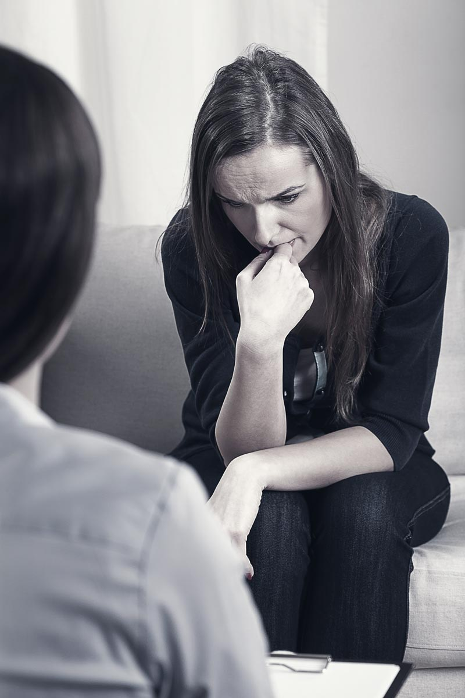
Self-care
Domestic and family violence (DFV) does not discriminate and will impact many health workers. The contents of this training will cause some participants to feel uneasy and/or trigger personal experiences, reactions and feelings.
If you or someone you know is affected, take the time and space you need.
You can seek assistance via:
The Employee Assistance Program
1800 RESPECT (1800 737 738)
A professional counsellor/specialist service
Queensland Government’s DFV portal for a list of local and state-wide support services
Notes:
Acknowledge that some participants will have personal or professional experience with DFV. Self-care is essential.

Slide 5
Supporting an employee experiencing DFV
Everyone deserves to be safe and supported in the workplace
Notes:
The experience of DFV can have serious impacts on a person’s physical, psychological and emotional health at a personal level and therefore on their attendance and performance at work.
Every organisation should have a policy that outlines the workplace’s commitment to supporting employees affected by DFV.
All Queensland Government public service employees affected by DFV can access support options, including a minimum of 10 days paid leave, counselling from Employee Assistance Programs (EAP), flexible work arrangements, and workplace and role adjustments where appropriate.
Queensland public sector employees can increase their understanding of DFV and how to support colleagues affected by DFV by completing the online Recognise, Respond, Refer program. For Queensland Health employees this training is available on https://qheps.health.qld.gov.au/hr/staff-health-wellbeing/domestic-family-violence/training
The Department of Health also provides training to all departmental managers to guide their approach to supporting employees who have experienced DFV.
Private health sector
Private health sector employees can increase their understanding of DFV and how to support colleagues affected by DFV by completing the online Recognise, Respond, Refer program available at https://www.challengedv.org/online-learning-2

Slide 6
Reflective practice
Responding appropriately and effectively in diverse contexts often means addressing one’s own attitudes, knowledge and actions as a learning process.
Notes:
Reflective practice is fundamental to professional development. It involves reflecting on how your personal views, beliefs and experiences impact on your clinical and personal responses. Individual and professional values and beliefs in relation to DFV issues may or may not be evidence-based so it is important to be self-reflective so that you are able to deliver the safest and most appropriate response to suspicions and disclosures.
Responding appropriately and effectively in diverse contexts often means addressing one’s own attitudes, knowledge and actions as a learning process. Being thoughtful and sensitively curious about the circumstances of others as well as self-reflective about how we come to hold our own values, is the most effective way of approaching professional practice in relation to DFV.
Seeking clinical advice from a team leader and/or DFV specialists within the health facility, such as a clinical area social worker, can assist in ensuring your response is appropriate.

Slide 7
Roles and responsibilities
It is important to know your role in relation to DFV is to recognise, respond and refer within your scope of practice.
Notes:
Professional competency standards, code of conduct and scope of practice were discussed in the Understanding Domestic and Family Violence online learning module and information booklet.
It is important to know your role as a health professional is to ask about DFV in a way that facilitates disclosure, in a private discussion, in a sensitive manner and in an environment where the person feels safe and is safe from immediate harm.
Your role in working with victims of DFV is to:
Offer a sensitive and caring approach.
Use your professional judgement and knowledge of risk factors to screen for immediate safety threat.
Where necessary, encourage the client to accept a referral for more comprehensive risk assessment and management.
Where the threat is high and immediate you may need to call the police, preferably but not exclusively with the client’s consent.
Share information on referral options so the client can make an informed decision about their current and future options.
Your role includes referral to professionals who have expertise in the area of DFV such as social workers, psychologists and specialist DFV services and workers who are trained to undertake assessment and therapeutic intervention. Many hospitals have social workers, and all areas in Queensland are covered by a specialist DFV service – have the contact details of both handy if further assessment and safety planning is required.
You may have a responsibility to report reasonable suspicions of child abuse and neglect to Child Safety Services. For more information and guidance regarding health workers’ child protection responsibilities, contact the Child Protection Unit in your hospital or go to https://qheps.health.qld.gov.au/csu/policy
Changes to Queensland’s Criminal Code for Child Sexual Offences require adults in an institutional setting to protect children from sexual offences. All adults are required to report sexual offences committed by another adult against a child or young person to Police. For more information go to https://qheps.health.qld.gov.au/csu/reporting-child-sexual-offences

Slide 8
Group Activity 2
Several definitions of DFV exist.
Develop your own definition of DFV.
Notes:
Ask participants to break into small groups to develop their own definition of DFV. Ask each group to share the definition they developed before moving onto the following slides that outline how DFV is defined in legislation.
Domestic violence occurs when someone in an intimate relationship uses fear, coercion or emotional manipulation to control their partner on an ongoing basis; it is an abuse of power by one person over another in that relationship. This ongoing pattern of behaviour may include a range of tactics that may be criminal and non-criminal in nature.
DFV can affect any person regardless of gender, age, socio-economic status, or cultural background. While both men and women can be victims and perpetrators of DFV, it is important to acknowledge that the rate of DFV perpetrated against women is significantly higher than it is against men.

Slide 9
Legislation
Domestic and Family Violence Protection Act 2012

Slide 10
Domestic and Family Violence Protection Act 2012
Definition:
Domestic violence means behaviour by a person (the first person) towards another person (the second person) with whom the first person is in a relevant relationship that—
is physically or sexually abusive; or
is emotionally or psychologically abusive; or
is economically abusive; or
is threatening; or
is coercive; or
in any other way controls or dominates the second person and causes the second person to fear for the second person’s safety or wellbeing or that of someone else.

Slide 11
Domestic and Family Violence Protection Act 2012
Definition:
Without limiting subsection (1), domestic violence includes the following behaviour—
causing personal injury to a person or threatening to do so;
coercing a person to engage in sexual activity or attempting to do so;
damaging a person’s property or threatening to do so;
depriving a person of the person’s liberty or threatening to do so;
threatening a person with the death or injury of the person, a child of the person, or someone else;
threatening to commit suicide or self-harm so as to torment, intimidate or frighten the person to whom the behaviour is directed;
causing or threatening to cause the death of, or injury to, an animal, whether or not the animal belongs to the person to whom the behaviour is directed, so as to control, dominate or coerce the person;
unauthorised surveillance of a person;
unlawfully stalking a person.

Slide 12
Section 5A of the Domestic and Family Violence Protection Act 2012 defines the circumstances under which some agencies can share information without consent to manage serious threats.
Section 315A of the Criminal Code 1899 defines non-lethal strangulation in DFV as a criminal offence.
Notes:
Section 5A of the Domestic and Family Violence Protection Act 2012 defines the circumstances under which agencies working with victims and perpetrators of DFV may share information without consent. Whilst seeking consent to release client information is always preferable, Section 5A allows agencies to share information where doing so will support the assessment and management of a serious DFV threat.
You are not obliged to report cases of non-lethal strangulation in DFV to the police but how you document the clinical presentation and treatment may impact on outcomes of criminal justice proceedings.
The Department of Health has collaborated with colleagues in the HHSs and have developed some quick-reference resources to guide busy clinicians to share information appropriately and safely, and to screen and respond to non-lethal strangulation in DFV.
https://www.health.qld.gov.au/__data/assets/pdf_file/0033/689433/Factsheet-Non-lethal-Strangulation.pdf
https://www.health.qld.gov.au/__data/assets/pdf_file/0036/689427/non-lethal-strangulation-flowchart.pdf

Slide 13
Duluth Model
The Duluth model underpins our knowledge of perpetrator behaviours.
Notes:
Power and control in a relationship can be gained by exercising behaviours such as intimidation, isolation, denying and blaming and male privilege.

Slide 14
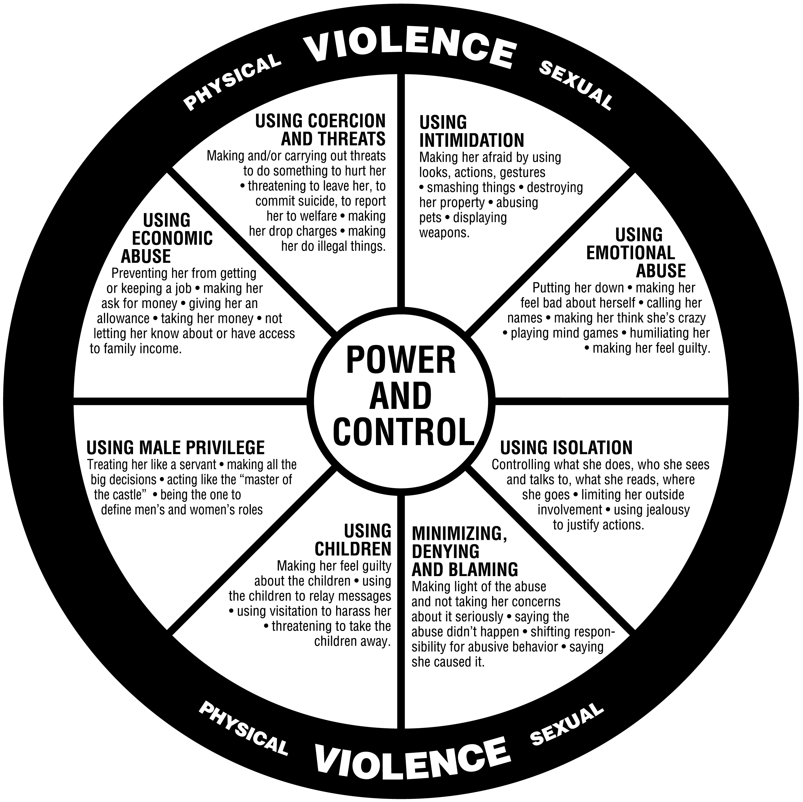
Notes:
The Duluth Power and Control Wheel is a helpful tool in understanding the overall pattern of abusive and violent behaviour used by perpetrators to establish and maintain control of their partner¹.
__________
1 Baird, K. Price, S. Salmon, D. (2005), Bristol Pregnancy and Domestic Violence Programme Training Pack, University of the West of England.

Slide 15
Complexities of DFV
Inequality adds to the complexity of people’s experiences of DFV.
People with disability
First Nations people and communities
People from culturally and linguistically diverse (CALD) backgrounds
Lesbian, gay, bisexual, trans, intersex and queer people (LGBTIQ+)
Gender
Notes:
It is important that DFV is understood within the context of structural and social inequalities rather than just the dynamics of individual relationships. Inequality is a key factor impacting on the incidence of DFV and on access to services by victims/survivors.
Everyone in the community, regardless of their sex, religion, cultural background, language, ability, relationship or living arrangements and has the right to feel safe and be safe in public and at home.

Slide 16
Group Activity 3
Identify how inequality impacts:
People’s vulnerability to violence
People’s experience of violence
People’s access to supports
Notes:
Ask participants to break into small groups and identify how inequality impacts people’s vulnerability to and experience of violence.
People with disability
People with disability experience more violence in intimate, family, informal and formal caring relationships than any other population group. Where there are relationships of dependency, people with disability can experience unique kinds of DFV e.g. withholding food, stimulation or medication or damage to mobility devices. People with disability also experience unique forms of discrimination. Regardless of their cognitive function, people with disability report being less likely to be asked about their experiences, less likely to be believed when they disclose abuse, that their choices are less likely to be respected and their needs less likely to be understood.
First Nations people
First Nations people and communities have higher rates of DFV. These elevated levels of violence are known to be one part of the interdependent impacts of colonisation which can include intergenerational trauma, grief and loss, poverty, and subsequent mental health issues and drug and alcohol use. Because of a history of unjust policies, First Nations people may be distrustful of mainstream services and systems but may also have confidentiality concerns when accessing First Nations-specific services. For those living in regional and remote areas there may be limited services and family members may not wish to move away from country and/or community to escape violence
Culturally and linguistically diverse (CALD) backgrounds
Women from CALD backgrounds are particularly vulnerable to DFV. This can be a result of social isolation, language barriers, a lack of knowledge regarding the service system and community stigma related to family breakdown. People from CALD backgrounds may avoid sharing their experiences as they may be unaware that it is a crime in Australia or they may not have any safe opportunity in which to share their experiences. Regardless of a person’s cultural beliefs and practices, DFV is never okay.
Lesbian, gay, bisexual, trans, intersex and queer people (LGBTIQ+)
Research shows that same-sex attracted people suffer violence in their intimate relationships at around the same rates as those in heterosexual relationships. LGBTIQ+ people may have experienced homophobia, transphobia and heterosexism when accessing mainstream services, and may have genuine concerns that their experiences of DFV will be seen as less valid and that their experiences and support needs will not be understood.
Gender
DFV is a gendered issue. While men can be victims of DFV, and women can be perpetrators, women and gender diverse people are significantly overrepresented as victims of violence and coercive behaviour, and men are both more likely to perpetrate violence and to perpetrate violence with more serious impacts.

Slide 17
DFV affects health
DFV can affect an individual’s health and wellbeing in a number of ways.
Notes:
The effects of living with violence include physical and psychological health impacts.

Slide 18
Group Activity 4
Identify what some of the health impacts of DFV might be.
Notes:
In small groups identify what some of the health impacts might be.
Indicators of DFV are outlined in the Understanding domestic and family violence module and include:
bruises
injury to parts of the body hidden from view
rape and sexual assault
miscarriages and other pregnancy complications
mental illness:
depression
panic attacks
anxiety
suicide.
DFV often commences or intensifies during pregnancy and is associated with increased rates of miscarriage, low birth weight, premature birth, foetal injury and foetal death. DFV during pregnancy is regarded as a significant indicator of future harm to the woman and her child.
The use of non-lethal strangulation in DFV often does not have obvious signs and symptoms, but is an indicator of increasingly severe violence and is a risk factor for domestic homicide.
Hand out a copy of the Non-lethal Strangulation in Domestic and Family Violence Factsheet and Flowchart. These resources can be used as quick-reference guides for use in busy clinical environments.
https://www.health.qld.gov.au/__data/assets/pdf_file/0033/689433/Factsheet-Non-lethal-Strangulation.pdf
https://www.health.qld.gov.au/__data/assets/pdf_file/0036/689427/non-lethal-strangulation-flowchart.pdf

Slide 19
NON-LETHAL STRANGULATION in DFV
Non-lethal strangulation in DFV:
➔ Is a stand-alone criminal offence in Queensland
➔ Is a significant indicator of a dangerous escalation in violence
➔ Is a risk factor for domestic homicide
➔ Has cumulative health impacts
➔ May cause serious injuries to the structures in the neck that are not visible to the eye, and for which there may be delayed and/or generalised symptoms.
Notes:
[new slide]

Slide 20
KEY INDICATORS FOR SERIOUSNESS:
Client reports:
Loss of consciousness;
Loss of bowel &/or bladder control;
Difficulty breathing &/or developed a cough &/or changes to voice
They thought they would die
SIGNS of non-lethal strangulation
Red eyes, petechiae in eyes, petechiae on skin on or above the neck, neck swelling or bruising, ligature marks on neck, droopy eyelid or face, tongue injury, lip injury, poor coordination, confusion
SYMPTOMS of non-lethal strangulation
Neck pain, jaw pain, sore throat, difficulty breathing, difficulty swallowing, vision changes, hearing changes, tinnitus, light headedness, headache, muscle weakness, voice changes, memory loss
Notes:
[New slide]

Slide 21
Potential health impacts of non-lethal strangulation
A lack of blood and oxygen supply to the brain can cause permanent neurological damage.
Damage to the arteries in the neck has been linked to stroke that may be delayed hours, days or weeks.
Damage to the hyoid bone can impede airways and cause difficulty when swallowing.
Psychological trauma is linked to chronic insomnia, post-traumatic stress, depression, anxiety and suicidality.
Responding to non-lethal strangulation presentations
ASK client directly about experiences of non-lethal strangulation
CHECK for signs and symptoms
CONSULT with specialists regarding need for further radiological testing
INFORM the client of dangers and health risks & REFER for further assessment
DOCUMENT presentation, treatment and referral
Notes:
[New slide]

Slide 22
“Why does she stay in the relationship?”
There are many valid reasons why women do not leave violent relationships.
Women experiencing DFV require understanding and continuing support from clinicians
without pressure for a specific
course of action.
NEVER ASK
“Why don’t you just leave?”
Notes:
It is important the clinicians understand the experiences and needs of women:
Never ask a victim “why don’t you just leave?”. This question is victim blaming and reflects a lack of understanding of the dynamics of DFV.
The clinician must communicate respectfully and ensure women have access to information about support services.
Clinicians should not push a woman to leave an abusive relationship as this may lead to an increased risk of violence.
It is essential women are supported to make their own decisions.
There are many reasons why women don’t leave violent relationships including:
the ‘high risk for violence’ periods include immediately prior to, during, or immediately after separation
concerns for the children if they leave the relationship, including fears of child safety intervention and that a violent ex-partner will get unsupervised access to the children
embarrassment and shame
financial reasons
love and care for the violent partner – violent people are unlikely to be ‘all bad’
low self-esteem as a result of prolonged emotional abuse.

Slide 23
Group Activity 5
Discuss and list how inequality and complexity can impact on women’s capacity to leave abusive relationships.
Notes:
In small groups discuss and list some of the complexities facing women from diverse backgrounds regarding leaving violent relationships.
Why it’s so hard for women to ‘just leave’:
First Nations people
Not wanting to draw negative attention to their community.
Not wanting be complicit in criminal justice responses against family/community members.
Fears that their children will be taken away.
Lack of access to local services and do not wish to move away from community and/or country.
Concerns about community backlash.
People with disability
Are unable to access information about supports available.
No opportunity to disclose abuse safely.
Fears that the DFV service system will not be accessible.
Dependency on perpetrator, fears that they will have no-one to care for them.
LGBTIQ+ people
Fear of discrimination, homophobic/transphobic abuse and heterosexism.
Fear of being ‘outed’.
Non-disclosure for fear of experiences not being believed/validated.
Fears that the DFV service system will not be accessible and/or will not understand their needs.
Concerns regarding discrimination when accessing services.
Women from CALD backgrounds
Language barriers resulting in a lack of information about the DFV service system and about their legal rights.
Fears that disclosing violence could impact their immigration status.
Perception that immigration status will limit access to protection and services (this may be true).
Cultural and religious beliefs regarding the privacy of the family.

Slide 24
Understanding power, vulnerability and DFV
People who have less power are more likely to experience DFV. Understanding the interplay of power, vulnerability and violence is key to understanding how and why DFV is able to continue in our homes and communities.
Consider how power and vulnerability impact on the experiences of the person/people in the videos.
Notes:
This video clip is the story of Tara Costigan a pregnant woman who was murdered by her partner http://www.abc.net.au/7.30/content/2016/s4503702.htm
There are other video clips available:
Dixie Link-Gordon is breaking down the code of silence on family violence https://www.youtube.com/watch?v=cq0BAFogyTc
Violence against people with disability https://www.youtube.com/watch?v=EovgP4YXjL8&feature=emb_logo
Ben Bjarnesen’s Story – End LGBTIQ Domestic and Family Violence https://www.youtube.com/watch?v=gSO-SDj-8ag

Slide 25
How DFV affects children
Children exposed to DFV will be at a higher risk of physical, emotional and behavioural problems that persist into adulthood.
Notes:
Health professionals should be aware of the close link between DFV and child abuse and neglect. It is important that health professionals when addressing DFV within their professional practice, understand their responsibilities relating to child protection.
Having a ‘child aware approach’ in circumstances of DFV encompasses consideration of the needs of the the unseen child when working within the adult hospital context. This will involve assessing both parental protective factors and parental risk factors. Does information at hand suggest the child has suffered, is suffering or is at an unacceptable risk of suffering significant harm and may not have a parent who is able and willing to protect them from the harm? If so then you are required to make a report to Child Safety.
For more information and guidance regarding health workers’ child protection responsibilities, contact the Child Protection Unit in your hospital or go to https://qheps.health.qld.gov.au/csu/policy

Slide 26
High risk population groups
Some people face barriers to accessing information, services, supports and legal protections. These barriers put them at a greater risk of experiencing DFV. They may need additional support or a different approach.
DO NOT use partners, other family members, children or carers as interpreters.
Notes:
First Nations people
It is important that higher rates of DFV in First Nations communities be understood within the context of intergenerational trauma and loss. First Nations people may be distrustful of mainstream services and systems or may have confidentiality concerns when accessing First Nations services. For those living in regional and remote areas there may be no support services and family members may not wish to move away from country and/or community to escape violence.
If you are a non-Aboriginal person responding to First Nations people impacted by family violence, ask the client if they would like to connect with an Aboriginal and/or Torres Strait Islander clinician, liaison officer or service. It might be useful to consult with an Aboriginal and Torres Strait Islander liaison officer or with a local cultural champion but in the interests of safety, do not share client details unless consent has been provided.
Women from CALD backgrounds
Women from CALD backgrounds are more likely than other women to experience marginalisation, social isolation and a lack of access to services, making them more vulnerable to DFV. If language assistance is required, always use professional interpreters, never rely on family members or children for interpreting. Wherever possible engage an interpreter who is not known to the family or the community. This can often be done by using telephone interpreters. Prepare yourself in advance by contacting your Hospital and Health Interpreter Service Coordinator to find out how to access language interpreting services.
People with disability
People with disability experience high levels of violence from family members and carers and in ways that may not be immediately noticeable, such as withholding mobility aids, food, medication or stimulation. Health clinicians should be mindful of how people with disability’s unique experiences of DFV intersect with their experiences of marginalisation and discrimination.
If you suspect violence or abuse against a client with a disability, ask the client directly and/or refer them on to a social worker or a DFV specialist worker to ensure their needs are fully assessed. Follow up may be required. Rather than rely on carers to facilitate communication with people requiring communication support, prepare yourself in advance by contacting your Hospital and Health Interpreter Service Coordinator to find out how to access disability interpreting services.
Ensure if a client is under the adult guardian or has a health attorney, they are consulted if the person does not have capacity to consent for health care.
Elderly people
Studies indicate that the perpetrators of elder abuse may be different to those who use violence in relation with younger women, with an increase in reporting of children, grandchildren, other relatives and carers as abusers. The Queensland Elder Abuse Prevention Unit (EAPU) helpline number is 1300 651 192.

Slide 27
Perpetrator risk factors and clinical response
Perpetrators of DFV come from all socio-economic, cultural and social groups.
Notes:
Perpetrator high-risk factors:
Perpetrators who have access to weapons, particularly guns, are much more likely to seriously injure or kill a victim than perpetrators without access to weapons.
Threats by the perpetrator to hurt or kill family members can be a way of controlling the victim, and is a risk factor for serious injury and homicide.
Escalation in severity and frequency of violence.
The use of non-lethal strangulation is a significant risk factor for increasingly dangerous levels of violence and for domestic homicide. Women may use terms such as choking or suffocating.
Intimate partner sexual violence is a significant risk factor for homicide.
Stalkers are more likely to be violent if they have had an intimate relationship with the victim. Stalking, when coupled with physical assault, is strongly connected to murder or attempted murder. Stalking behaviour and obsessive thinking are highly related behaviours.
Obsessive and/or excessive jealous behaviour is often related to controlling behaviours and has been linked with violent attacks.
Other risks include the perpetrator making suicide threats and attempts, court orders or parenting proceedings, misuse of drugs and alcohol and abuse of pets and other animals.
[Ref: ANROWS National Risk Assessment Principles for domestic and family violence]
Clinical response
Perpetrators of DFV come from all socioeconomic, cultural and social groups, and will access health services. It is important to understand how to respond to clients who you know/suspect are perpetrators of DFV.
The safety of victims and their children is paramount and health clinicians should be careful not to engage with perpetrators in ways that increase the risk of DFV.
Never breach the confidentiality of victims and their children to the perpetrator.
Do not engage with a perpetrator about their behaviour unless the perpetrator discloses their DFV, or unless you have an ongoing relationship of trust.
Do not confront perpetrators in an accusatory manner or in a way that will shame or anger them.
Do not collude with the perpetrator in attempts to minimise, excuse or justify the violence, or blame the victim.
Respond to disclosures with curiosity, maintaining the focus on perpetrator behaviour and encouraging consideration of the impact of the violence on family members.
Refer to services that may support positive behaviour change and/or increase victim safety. With consent, you can refer to one of a number of perpetrator programs available in Queensland. These can be accessed via the Queensland Government’s DFV service portal.
[Ref: http://www.thelookout.org.au/family-violence-workers/working-perpetrators/tips-engaging-men-their-use-family-violence]

Slide 28
Principles of sensitive practice
Sensitive practice is an approach to engaging with clients in a way that increases their feelings of safety, respect and control.
Notes:
Discuss the principles of sensitive practice.
Remind participants that these principles can be applied to all clinical practice and across all disciplines.
A supportive response from a well-trained professional can act as a turning point on the pathway to safety and healing.
Respect – experiences of abuse may undermine a client’s personal worth and that they may be sensitive to not being listened to or believed. Listening to and validating belief in a client’s experiences will help them feel respected
Taking time – feeling that a clinician is taking time to listen to them and feeling genuinely heard is a contributing factor to healing and in some cases may be the best intervention a clinician can offer
Rapport – building rapport with a client will increase their sense of safety and assists to encourage both communication and cooperation.
Sharing information – this is a process whereby information is exchanged and both parties feel heard and understood. Sharing information with the client also allows them to make informed decisions regarding their health and the health of their children.
Supportive – being supportive means accepting a client as an individual with unique beliefs, values, needs and history.
Respectful – seek permission from your client to ask questions of an intimate nature or before performing an examination.
Create a sense of control – clients who have experienced DFV may be sensitive to having control taken away from them from people in positions of power. Sharing control of actions and discussion in the clinician-client relationship will support the client’s sense of safety and allow clients to participate in their own care.

Slide 29
Group Activity 7
How would you feel about sharing personal matters?
What do you consider to be possible barriers to disclosure?
Notes:
As a larger group consider a brain storming exercise, asking participants about how they would feel sharing personal matters e.g. relationship problems, how they would want this approached in a health setting, etc.
What would be important for them if they were the client?
As a group identify what they could consider as possible barriers for the client around disclosure (e.g. social isolation, fear, etc.)

Slide 30
Six steps to sensitive inquiry
Notes:
Health professionals can reduce the barriers for victims/survivors by receiving appropriate training and education in sensitive inquiry and appropriately responding to DFV.

Slide 31
Step 1 – Identification
DFV can be identified through:
client disclosure
recognising indicators
recognising risk factors
outline screening
Notes:
Identification of DFV through recognising high risk groups, risk factors and health indicators is key to initiating conversation about DFV with a client.
If a clinician suspects DFV, conversations with the client should take place alone and in a private place.
Ensure the client is comfortable and consenting to the discussion.
Clients may be reluctant to disclose DFV due to a range of factors including:
pressure from families, friends or abusers to remain silent fear of a negative response
the sense that health professionals do not have the time to listen or seem unaware of the potential long term impacts.
Clients who have experienced DFV generally want to be asked about their experiences, and are more likely to make a disclosure.

Slide 32
Group Activity 8
Identify risk factors and indicators of DFV.
Notes:
In small groups identify risk factors and indicators of DFV.
Review with the group the list of risk factors or indicators of DFV.
Risk factors
Victim risk factors:
victim’s perception of risk
pregnancy and the postnatal period
isolation.
Relationship risk factors:
recent separation or plans to separate
parenting orders and court proceedings
financial hardship or stress.
Perpetrator risk factors:
intimate partner sexual violence
non-lethal strangulation
increase in severity and/or frequency in violence
threats to seriously harm or kill
mental health issues particularly suicide threats and attempts
drug and alcohol abuse
history of violence
access to weapons
patterns of coercive control.
Indicators in adults
The following indicators are associated with victims/survivors of DFV and may be signs for identification during a health service presentation.
Physical:
unexplained bruising and other injuries (especially to the head and neck)
bruises at various stages of healing
injuries on parts of the body hidden from view (including breasts, abdomen and/or genitals), especially if pregnant
injuries sustained that do not fit the history given
‘accidents’ occurring during pregnancy
miscarriages and other pregnancy complications.
Psychological/behavioural:
emotional distress e.g. anxiety, indecisiveness, confusion and hostility
multiple presentations at the surgery
sleeping and eating disorders
partner does most of the talking and insists on remaining with the client
anxiety/depression/pre-natal depression
seeming anxious in the presence of the partner
psychosomatic and emotional complaints
reluctance to follow advice
self-harm or suicide attempts
social isolation/no access to transport
submissive behaviour/low self esteem
drug and alcohol abuse.
Indicators in children
The following indicators are associated with victims/survivors of DFV and may be signs for identification during a health service presentation.
Physical:
• difficulty eating/sleeping
• physical complaints
• slow weight gain (in infants)
• eating disorders.
Psychological/behavioural:
• aggressive behaviour and language
• dependent, sad or secretive behaviours
• depression, anxiety and/or suicide attempts
• bedwetting
• appearing nervous and withdrawn
• ‘acting out’, for example cruelty to animals
• difficulty adjusting to change
• noticeable decline in school performance
• regressive behaviour in toddlers
• fighting with peers
• delays or problems with language development
• overprotective or afraid to leave parent
• psychosomatic illness
• stealing
• social isolation
• restlessness and problems with concentration
• abuse of siblings or parents
• exhibiting sexually abusive behaviour
• alcohol and other drug use
• feelings of worthlessness
• psychosomatic and emotional complaints.

Slide 33
Step 2 – Supportive response
An initial supportive response will assist in building rapport between the health professional and the client.
Provide a supportive environment for victims to share information.
Notes:
A supportive and professional response from health care providers can reinforce to a client that they are entitled to a healthy relationship and a life free from violence.
Focusing on the needs of the individual can be achieved through displaying empathy, a non-judgemental attitude, offering privacy and explaining confidentiality and its limits.
Opening statements are a way of introducing the subject of DFV using words that affirm the client is not being targeted or judged:
“DFV is a health issue that we ask about routinely.”
“As we know, DFV affects your health and we are routinely asking clients about it.”
Clinicians responding to a disclosure of DFV should do the following:
non-judgemental and careful listening
communicate belief
validate the experience of abuse
affirm that violence is unacceptable behaviour
show support towards the victim
make an initial safety assessment
ask about their experiences of non-lethal strangulation/choking/suffocating
respond to any concern about safety.

Slide 34
Group Activity 9
Role play how you would sensitively inquire about DFV
Notes:
In pairs ask participants to practice through role play how they would sensitively inquire about DFV.
Clinicians can ask broad questions:
“How are things at home?”
“Is there anything else happening which might be affecting your health?”
Clinicians can ask direct questions:
“Are there ever times when you are frightened of your partner?”
“Has your partner ever physically threatened or hurt you?”
Clinicians can ask specific questions:
“When I see injuries like this I wonder if someone could have hurt you?”
“Is there anything else we haven’t talked about that might be contributing to your condition?”
It is important to practice asking the questions about DFV so you feel comfortable with them. In pairs take turns to play the part of the clinician and the client:
Ask a client about their experience of DFV.
Respond to a positive disclosure.
What would be their key messages?
Consider verbal and non-verbal communication.
Reflect on:
communication skills including body language
interactions between pairs conducting the role play.

Slide 35
Step 3 –
Consider risk and safety
Consideration of safety is an important step in determining how to respond.
Notes:
All health clinicians have a role in engaging sensitively to undertake safety screening to guide their clinical response to DFV. When screening for a client’s safety the health professional will use a combination of:
knowledge of evidence based risk factors
the victim’s own perception of safety and risk
professional judgement.
The evidence shows that comprehensive DFV risk assessment and management is an ongoing process that should be undertaken by specially trained staff such as social workers or specialist DFV workers. Comprehensive assessment of risk is important to identify dangers to victims including risk of serious harm, homicide, suicide or self-harm and risk to their children. Risk should be monitored regularly and necessary steps should be taken where immediate safety concerns are identified.
The key responsibilities for most health clinicians are to understand the risk factors for DFV, to use sensitive inquiry to screen for those risk factors, and to use their clinical judgement to understand when a referral for a further risk assessment or need to ensure immediate safety is required.
The Domestic and Family Violence Prevention Act 2012 defines how Queensland Health and other agencies can share relevant information with one another in order to assess and manage serious DFV threats.
Hand out a copy of the Information Sharing in Domestic and Family Violence Factsheet and Flowchart. These resources can be used as quick-reference guides for use in busy clinical environments.
https://www.health.qld.gov.au/__data/assets/pdf_file/0038/689429/factsheet-dfv-info-sharing.pdf
https://www.health.qld.gov.au/__data/assets/pdf_file/0036/689427/non-lethal-strangulation-flowchart.pdf
In some facilities or at certain times there may not be access to a social worker or specialist DFV service. In this case you should refer to DFV expert within your clinical area or telephone advice from a specialist DFV service e.g. DV Connect (1800 811 811).

Slide 36
Group Activity 10
Scenario based activity
Notes:
Provide the group with a clinical scenario from the Clinical response to Domestic and Family Violence Training facilitator guide (page 20) and ask participants to work through their approach to safety screening and the different ways they would respond to risk. Groups are to record their feedback on butcher’s paper and share with the larger group.
Example responses:
A series of admissions for suspicious injuries for which the cause is not clear - use sensitive inquiry to see if DFV may be a factor.
There is an immediate serious threat to victim and children: Contact ‘000’, Contact DVConnect to support women/children in accessing a DFV shelter.
No high risk factors apparent for the perpetrator, but violence has occurred in the past and the victim is considering leaving the relationship: Offer a referral for further assessment by a social worker or a DFV specialist worker.
A DFV victim is accessing a drug and alcohol service and is experiencing post traumatic stress after experiencing DFV in the past: Access the Queensland Government DFV Portal to find therapeutic counselling services.

Slide 37
Step 4 –
Actions for safety
Plan for safety in partnership with the client.
Notes:
Following medical and clinical assessment and during engagement with your client, their immediate safety should be given first priority. If this is not a concern, the clinician should consider the individual’s future safety and ongoing care by asking some specific questions.
Give examples of what questions you would ask to determine immediate safety.
Give examples of questions to determine future safety.
What does an emergency plan look like for your client?
Has the perpetrator ever attempted to strangle, choke or suffocate your client?

Slide 38
Group Activity 11
Develop an emergency plan and role play activity
Notes:
An emergency plan is the development of a plan by health professionals in consultation with victims to achieve and maintain their safety.
It may include:
compiling a list of emergency numbers
helping to identify a safe place for the victim to go and how they will get there
identifying family and friends who can provide support
ensuring cash is available
providing a safe place to store valuables and important documents.
Ask the group to develop an emergency plan.
Role play working through an emergency plan with the client.
Identify possible issues/barriers.

Slide 39
Step 5 –
Referral support
With the consent of the client offer referral options.
Notes:
Introduce the Domestic and Family Violence - Referral to specialist support services model (Referral Model).
Hand out a copy of the Referral Model and Flowchart.
https://www.health.qld.gov.au/__data/assets/pdf_file/0021/465132/dv-referral-model.pdf
https://www.health.qld.gov.au/__data/assets/pdf_file/0025/635803/dv-referral-flowchart.pdf
Talk about how contact details of referral agencies can be found i.e. DVConnect, Queensland Government DFV portal.

Slide 40
Step 6 – Documentation/ reporting
Documentation of relevant information especially about physical injuries is important for ongoing care and for legal purposes.
Notes:
What should health professionals include when documenting an awareness or disclosure of DFV?
It is important to document a disclosure of, and responses to, any signs/symptoms of non-lethal strangulation as the health impacts of this type of violence are cumulative.
If, as per the DFV information sharing guidelines, you have shared client information with other agencies for the purpose of a risk assessment or threat reduction, it is essential that a detailed record is kept of the reason/s why information was shared, what information was shared and with whom it was shared.
Use your local facility policy and guidelines to guide your documentation of your response to a disclosure of DFV including an assessment or safety plan.

Slide 41
Group Activity 12
How would you document a disclosure in the client’s clinical record?
Notes:
Ask the participants how they would document a disclosure in the clients clinical record.
Provide the participants with examples of a good and not so good case note to demonstrate what key information would be needed following local procedures around record keeping.

Slide 42
Conclusion
Next steps
Notes:
The Clinical response to Domestic and Family Violence train the trainer program (train the trainer) is now concluded.
The aim of the train the trainer session was to build on existing knowledge and provide you with additional expertise to enable you to deliver face to face training sessions to clinicians in relevant clinical areas.
You should leave the train the trainer session with confidence to deliver face to face training sessions on DFV:
The Clinical response to Domestic and Family Violence face to face training session, or any part of that session, will be delivered by a clinician who has completed the full one-day version of the train the trainer program.
The face to face training should be conducted in partnership with the local specialist DFV service.
The DFV training is supported by PowerPoint slides containing key messages for discussion.
Scenario based role play and group activities will be used to facilitate skills development.
Pre and post training evaluation questionnaire is available – refer to the Clinical response to Domestic and Family Violence Training facilitator guide. https://www.health.qld.gov.au/__data/assets/pdf_file/0022/465151/cr-dv-facilitator-guide.pdf

