Slide 1
Advance care planning documentation and processes in your facility
ACP training session 3 for all staff
INSERT FACILITY NAME HERE
Notes:
Facilitator notes
Preparation
Insert your facility name into this slide.
Require internet/ video/ audio access.

Slide 2
Learning outcomes
After completing this session, you should be able to:
List the three advance care planning documents that are commonly used in Queensland
Locate where residents’ advance care plans are kept in your facility
Understand the advance care planning processes within your facility.
Notes:
Facilitator notes
Key points
The learning outcomes provide the participants with a clear outline of the training session.
It may be appropriate to ask the participants if they have any questions before you commence the session.
Suggested activity
This brainstorming activity will enable you to gain an understanding of what the participants’ learning needs are.
Ask the participants what they would like to learn from the session and write up on a whiteboard or butcher’s paper.
At the end of the session, return to the list and ensure that you address any points that have not been answered. Some points may be covered in the other two training sessions supplied in this ACP Train-the-Trainer Guide. Or you may choose to set up another session to address these points or if it is an individual need that was not met, you may wish to meet with that person after the session and discuss.

Slide 3
Advance care planning documents commonly used in Queensland
These include:
Advance Health Directive (AHD)
Enduring Power of Attorney (EPOA)
Statement of Choices (SoC)
Service providers should not complete these forms on behalf of residents.
Notes:
Facilitator notes
Key points
Not all staff will be required, within their scope of practice, to complete these forms. However, being aware of their function and differences is beneficial.
Point out that these documents are often referred to by their acronyms.
Depending on the wishes of a resident and/or substitute decision maker, the advance care planning discussions could be documented in the resident’s notes or more formally in advance care plan documents.
In Queensland, a documented advance care plan usually consists of one or more of these three documents. At the very least it is recommended that an EPOA is completed to appoint a substitute decision maker(s).
The following slides give a brief overview on each document.

Slide 4
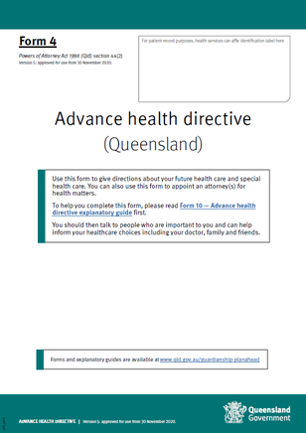
Advance Health Directive
A legally binding document
Can only be made by an adult with decision-making capacity
Allows a person to give directions about future health care and special health care
Can also be used to formally appoint an attorney(s) for health matters
A Doctor or Nurse Practitioner is required to compete the certificate stating the person has capacity to make the document
To be complete, an AHD must also be witnessed by an eligible witness
See the AHD explanatory guide for more information.
Notes:
Facilitator notes
Key point
Highlight the key points about the Advance Health Directive as written on the slide.
Suggested activity
Have a hard copy of the Advance Health Directive to show the participants what it looks like.
You may wish to highlight certain sections of the Advance Health Directive of interest.
Resources
Advance Health Directive. Available at: https://www.publications.qld.gov.au/dataset/power-of-attorney-and-advance-health-directive-forms/resource/56b091a2-4c65-48a0-99e1-01661c4d9e77
Advance Health Directive Explanatory Guide. Available at: https://www.publications.qld.gov.au/dataset/power-of-attorney-and-advance-health-directive-forms/resource/e904421c-b1e7-4f43-a918-474ae8c496fa?truncate=30&inner_span=True
Advance Care Directives. Available at: https://end-of-life.qut.edu.au/advance-care-directives#547395

Slide 5
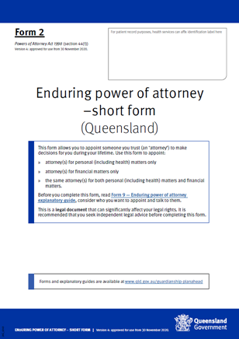
Enduring Power of Attorney
A legally binding document
Can only be made by an adult with decision-making capacity
Allows a person to legally appoint an attorney(s) for personal (including health) and/or financial matters and set out terms for how and when the power operates
An EPOA must be witnessed by an eligible witness
See the EPOA explanatory guide for more information
Notes:
Facilitator notes
Key point
Highlight the key points about the Enduring Power of Attorney as listed on the slide.
Suggested activity
Have a hard copy of the Enduring Power of Attorney to show the participants what it looks like.
You may wish to highlight certain sections of the Enduring Power of Attorney of interest.
Resources
Enduring Power of Attorney. Available at: https://www.publications.qld.gov.au/dataset/power-of-attorney-and-advance-health-directive-forms/resource/4a5d8235-28d3-4bee-af76-b5cb92b4d787?truncate=30&inner_span=True or
Enduring Power of Attorney Explanatory Guide. Available at: https://www.publications.qld.gov.au/dataset/power-of-attorney-and-advance-health-directive-forms/resource/17942707-4c02-4c98-af31-48b8ebcb957e?truncate=30&inner_span=True or
Substitute decision-making in Queensland at the end of life. Available at: https://end-of-life.qut.edu.au/treatment-decisions/adults/state-and-territory-laws/queensland#547985

Slide 6
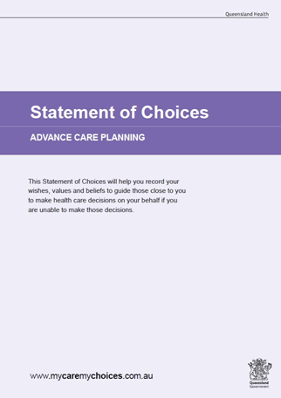
Statement of Choices
Is a values-based document that is not legally binding, and does not provide consent to, or refusal of, treatment
It is used to record a person’s wishes and preferences for health care into the future
Form A is used by people who can make health care decisions for themselves
Form B is used for people who cannot make health care decisions on their own
Notes:
Facilitator notes
Key point
Highlight the key points about the Statement of Choices (SoC) as listed on the slide.
Outline the sections of the SoC
Suggested activity
Have a hard copy of the SoC to show the participants what it looks like.
You may wish to demonstrate how to complete certain sections of the SoC utilising the interactive feature on https://metrosouth.health.qld.gov.au/acp/statement-of-choices-form
Resources
Statement of Choices. Metro South Health, Statement of Choices Advance Care Planning (Version 5.1), February 2018. Available at https://metrosouth.health.qld.gov.au/acp/statement-of-choices-form or
In Workshop resources located in Section 2 of the Guide.

Slide 7
Resident’s ACP documentation [INSERT YOUR FACILITY NAME]:
Q. Where can you find a resident’s:
Advance Health Directive?
INSERT LOCATION HERE
Enduring Power of Attorney?
INSERT LOCATION HERE
Statement of Choices?
INSERT LOCATION HERE
Note: Clinicians can check for ACP documents on the ACP Tracker via the Health Provider Portal
Notes:
Preparation
Locate where your residents’ advance care planning documents are filed.
Prior to your presentation type the relevant information into the slide where it says INSERT LOCATION HERE.
Identify the alerts/flags used in your facility for advance care planning documents.
Key points
The purpose of this slide is to inform personal care workers about where advance care planning documentation is located in your facility.
Inform personal care workers about the alerts/flags.
Resources
Bring anything to the training session that you think may be useful for the participants to see e.g. policy/procedures folders, residents case notes.
Prepare hard copy HANDOUT from Health Provider Portal website (HPP brochure, located in Section 4: Steps for Accessing The Viewer via the Health Provider Portal in the Guide

Slide 8
Organisational ACP documentation: policy [INSERT YOUR FACILITY NAME]
Q. What is our ACP policy statement?
INSERT YOUR FACILITY’S ACP POLICY STATEMENT TITLE HERE
Q. Where can it be found?
INSERT LOCATION HERE
Notes:
Facilitator notes for slides 8 and 9
Preparation
Locate your facility’s advance care planning organisational policy and procedures documentation.
Prior to your presentation type the relevant information into the slides where it says INSERT HERE.
These two slides are designed with the questions to show on the first mouse click and the answers slide in on the second click.
Key points
The purpose of this slide is to inform staff about what advance care planning policy and procedures exist in your facility.
Keep this very simple – the goal is that your staff know:
what the advance care planning policy and procedures are for your facility
where they are kept.
If your facility doesn’t have an advance care planning policy and procedures or they are under development you may wish to insert information from the Example Policy and Procedure: Implementation of Advance Care Planning in Residential Aged Care Facilities, in Section 4 of the Guide.
Resources
Bring anything to training session that you think may be useful for the participants to see e.g. policy/procedures folders, residents’ case notes etc.

Slide 9
Organisational ACP documentation: procedures [INSERT YOUR FACILITY NAME]
Q. How do we do advance care planning?
INSERT 4 -6 KEY POINTS FROM YOUR ACP PROCEDURES HERE
Q. Where can this paperwork be found?
INSERT LOCATION HERE
Q. How are the residents’ ACP documents shared across other
health care settings?
A. By sending ACP documents to the Statewide Office of Advance Care
Planning (OACP) to be uploaded to the ACP Tracker via The Viewer
Notes:
As per notes on slide 8
Hand out OACP factsheet: Steps for completed ACP documents to be uploaded to The Viewer from Section 4 in the Guide.

Slide 10
Let’s recap
The three advance care planning documents that are commonly used in Queensland are: Advance Health Directive, Enduring Power of Attorney, Statement of Choices
It is important for all care staff to know where to locate the residents’ advance care plans, and how they are used
It is recommended that all staff understand the advance care planning processes within the facility in order to participate in the provision of holistic, person-centred care.
Notes:
Facilitator notes
Key points:
Simply read out the contents of the slide

Slide 11
Notes:
Facilitator notes
Key points:
Give time for questions as it is very important staff know the fundamentals of ACP documentation and storage.
Answer as many questions as you can in the time available.
Any outstanding questions should be noted and a time to address these queries made for the near future.

Slide 12
References
Advance Health Directive. Available at: https://www.publications.qld.gov.au/dataset/power-of-attorney-and-advance-health-directive-forms/resource/56b091a2-4c65-48a0-99e1-01661c4d9e77
Advance Health Directive Explanatory Guide. Available at: https://www.publications.qld.gov.au/dataset/power-of-attorney-and-advance-health-directive-forms/resource/e904421c-b1e7-4f43-a918-474ae8c496fa?truncate=30&inner_span=True
Enduring Power of Attorney. Available at: https://www.publications.qld.gov.au/dataset/power-of-attorney-and-advance-health-directive-forms/resource/4a5d8235-28d3-4bee-af76-b5cb92b4d787?truncate=30&inner_span=True
Enduring Power of Attorney Explanatory Guide. Available at: https://www.publications.qld.gov.au/dataset/power-of-attorney-and-advance-health-directive-forms/resource/17942707-4c02-4c98-af31-48b8ebcb957e?truncate=30&inner_span=True
Statement of Choices. Available at: https://metrosouth.health.qld.gov.au/sites/default/files/soc-qldhealth.pdf

